Slide 1
Data Mining Classification: Alternative Techniques
Lecture Notes for Chapter 5
Introduction to Data Mining
by
Tan, Steinbach, Kumar

Slide 2
Rule-Based Classifier
Classify records by using a collection of “if…then…” rules
Rule: (Condition) → y
where
Condition is a conjunctions of attributes
y is the class label
LHS: rule antecedent or condition
RHS: rule consequent
Examples of classification rules:
(Blood Type=Warm) ∧ (Lay Eggs=Yes) → Birds
(Taxable Income < 50K) ∧ (Refund=Yes) → Evade=No

Slide 3
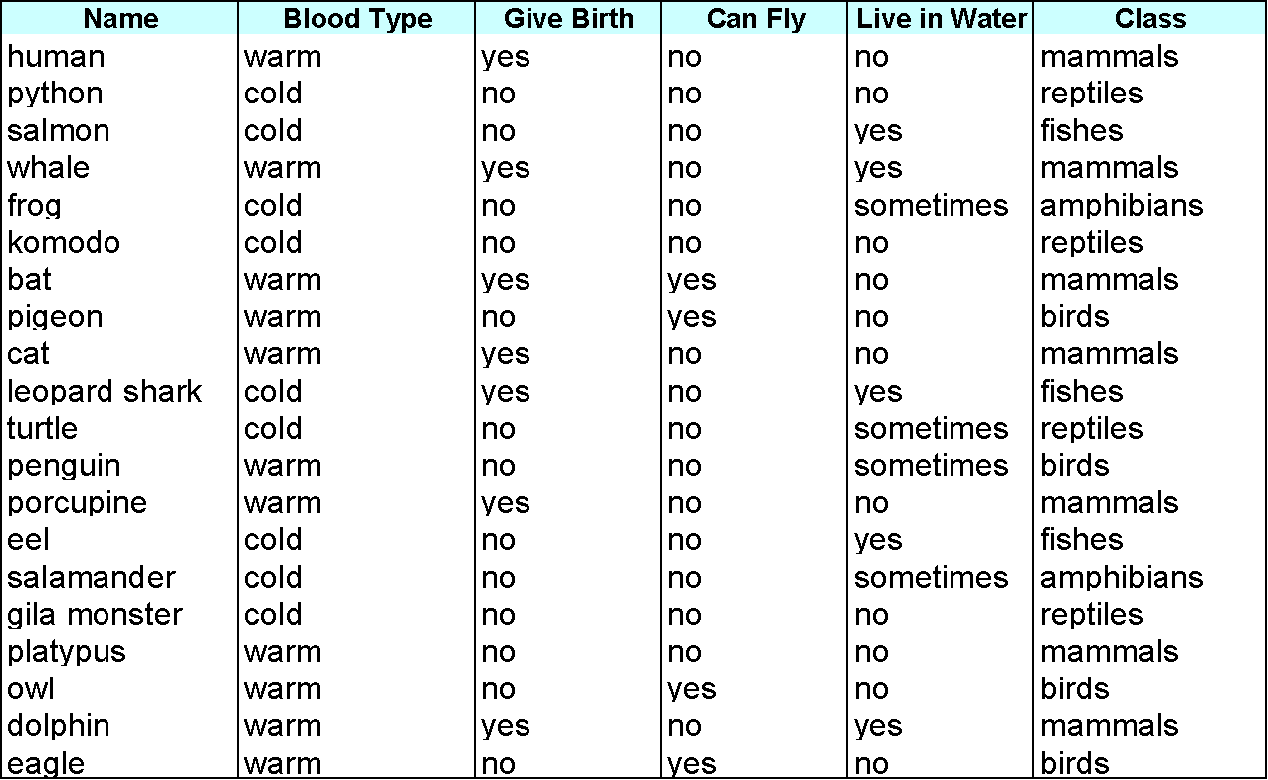
Rule-based Classifier (Example)
R1: (Give Birth = no) ∧ (Can Fly = yes) → Birds
R2: (Give Birth = no) ∧ (Live in Water = yes) → Fishes
R3: (Give Birth = yes) ∧ (Blood Type = warm) → Mammals
R4: (Give Birth = no) ∧ (Can Fly = no) → Reptiles
R5: (Live in Water = sometimes) → Amphibians

Slide 4
Application of Rule-Based Classifier
A rule r covers an instance x if the attributes of the instance satisfy the condition of the rule
R1: (Give Birth = no) ∧ (Can Fly = yes) → Birds
R2: (Give Birth = no) ∧ (Live in Water = yes) → Fishes
R3: (Give Birth = yes) ∧ (Blood Type = warm) → Mammals
R4: (Give Birth = no) ∧ (Can Fly = no) → Reptiles
R5: (Live in Water = sometimes) → Amphibians
The rule R1 covers a hawk => Bird
The rule R3 covers the grizzly bear => Mammal

Slide 5
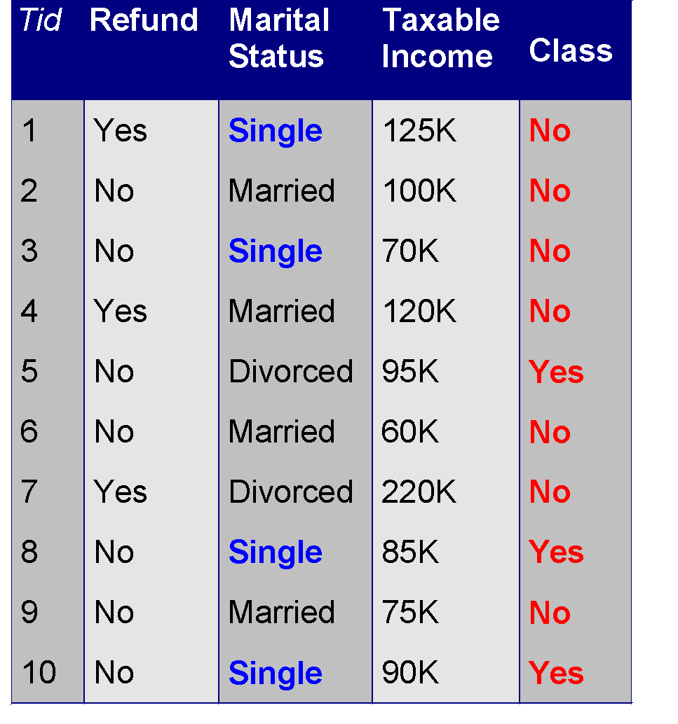
Rule Coverage and Accuracy
Coverage of a rule:
Fraction of records that satisfy the antecedent of a rule
Accuracy of a rule:
Fraction of records that satisfy both the antecedent and consequent of a rule
(Status=Single) → No
Coverage = 40%, Accuracy = 50%

Slide 6
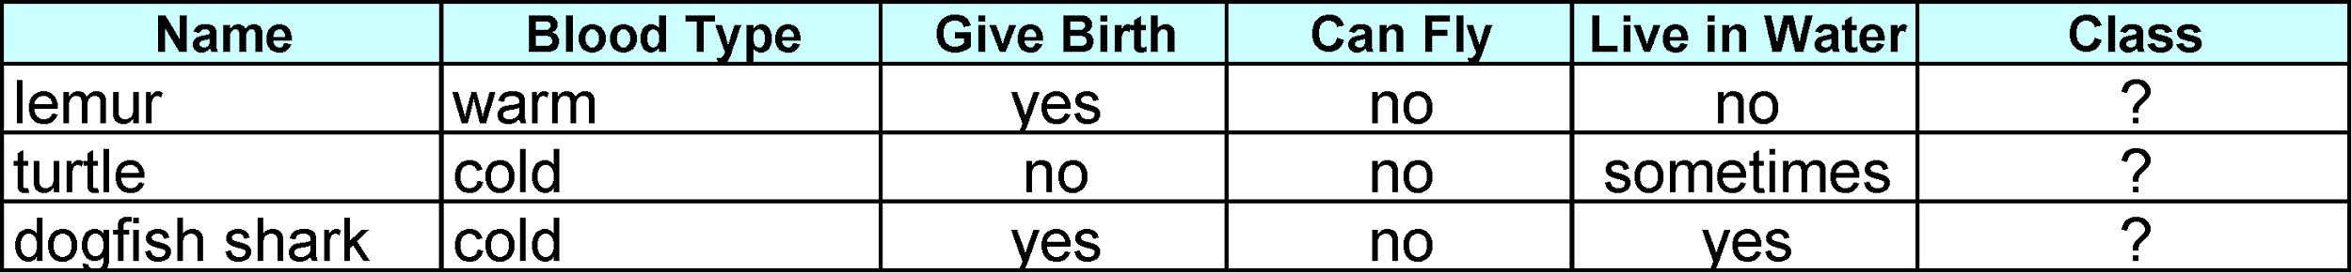
How does Rule-based Classifier Work?
R1: (Give Birth = no) ∧ (Can Fly = yes) → Birds
R2: (Give Birth = no) ∧ (Live in Water = yes) → Fishes
R3: (Give Birth = yes) ∧ (Blood Type = warm) → Mammals
R4: (Give Birth = no) ∧ (Can Fly = no) → Reptiles
R5: (Live in Water = sometimes) → Amphibians
A lemur triggers rule R3, so it is classified as a mammal
A turtle triggers both R4 and R5
A dogfish shark triggers none of the rules

Slide 7
Characteristics of Rule-Based Classifier
Mutually exclusive rules
Classifier contains mutually exclusive rules if the rules are independent of each other
Every record is covered by at most one rule
Exhaustive rules
Classifier has exhaustive coverage if it accounts for every possible combination of attribute values
Each record is covered by at least one rule

Slide 8
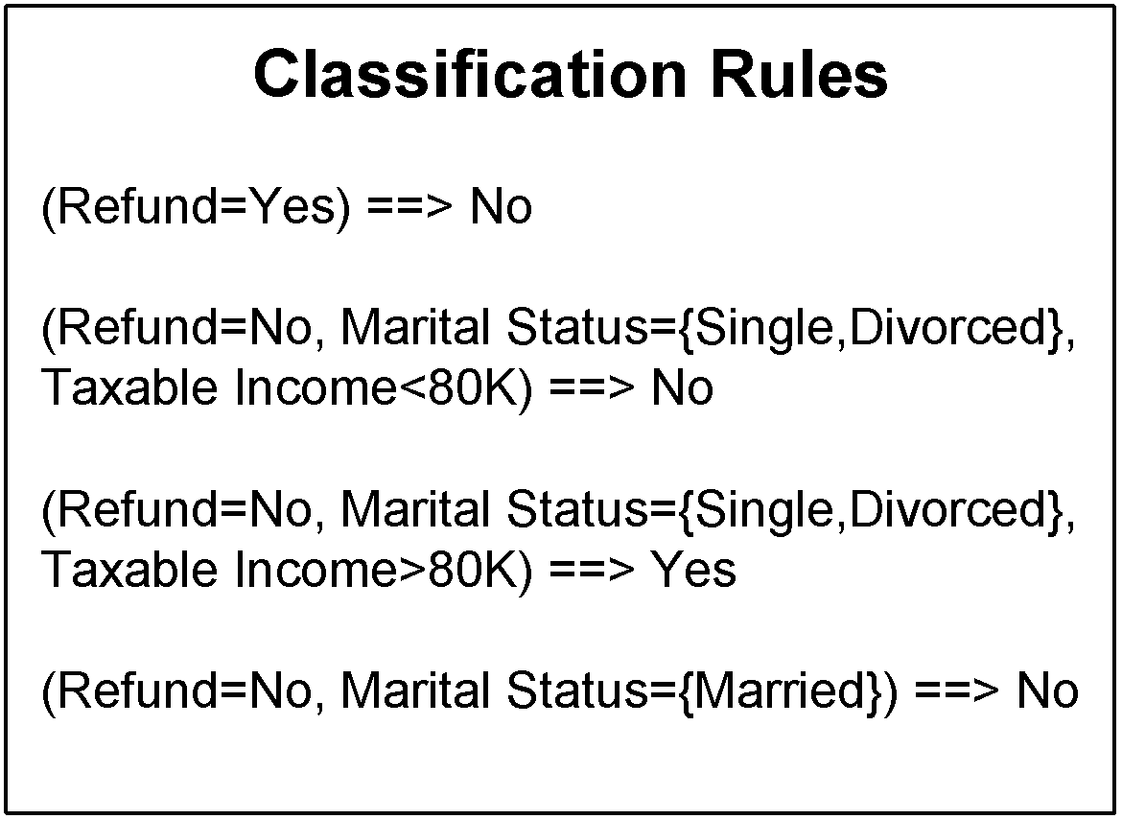
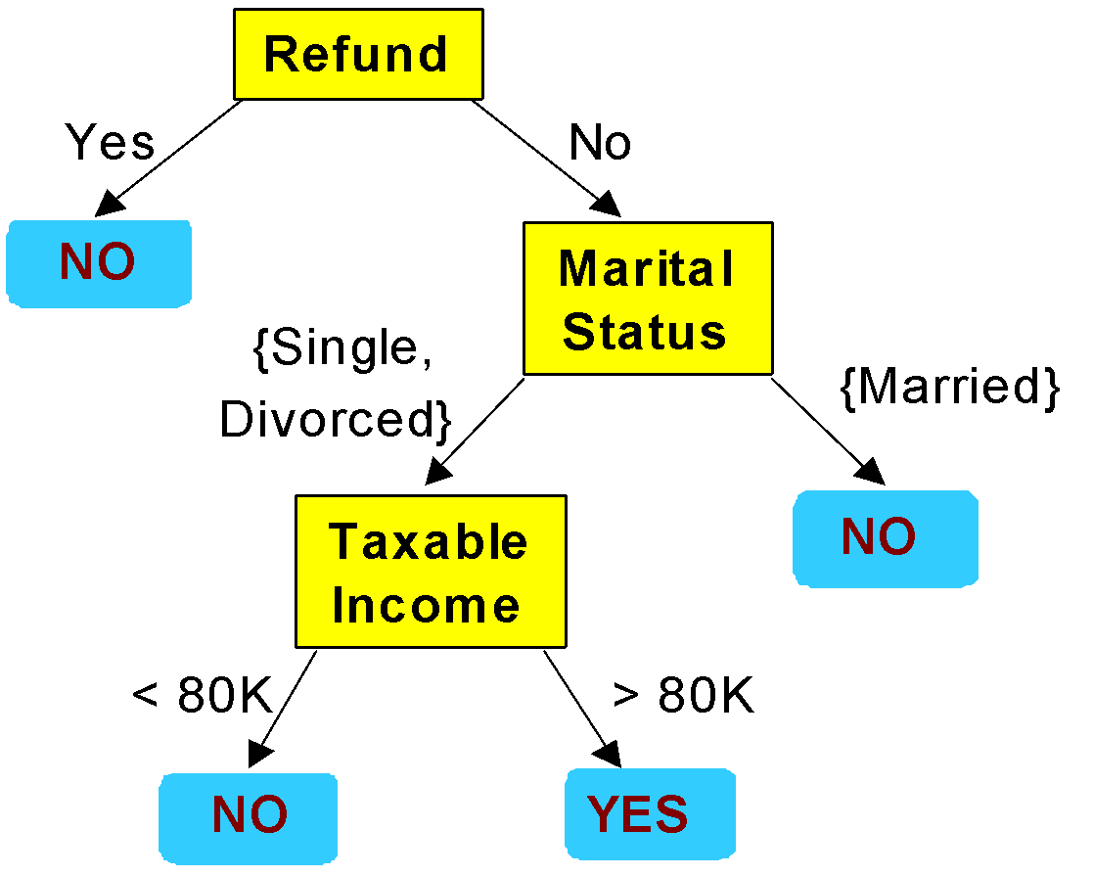
From Decision Trees To Rules
Rules are mutually exclusive and exhaustive
Rule set contains as much information as the tree

Slide 9
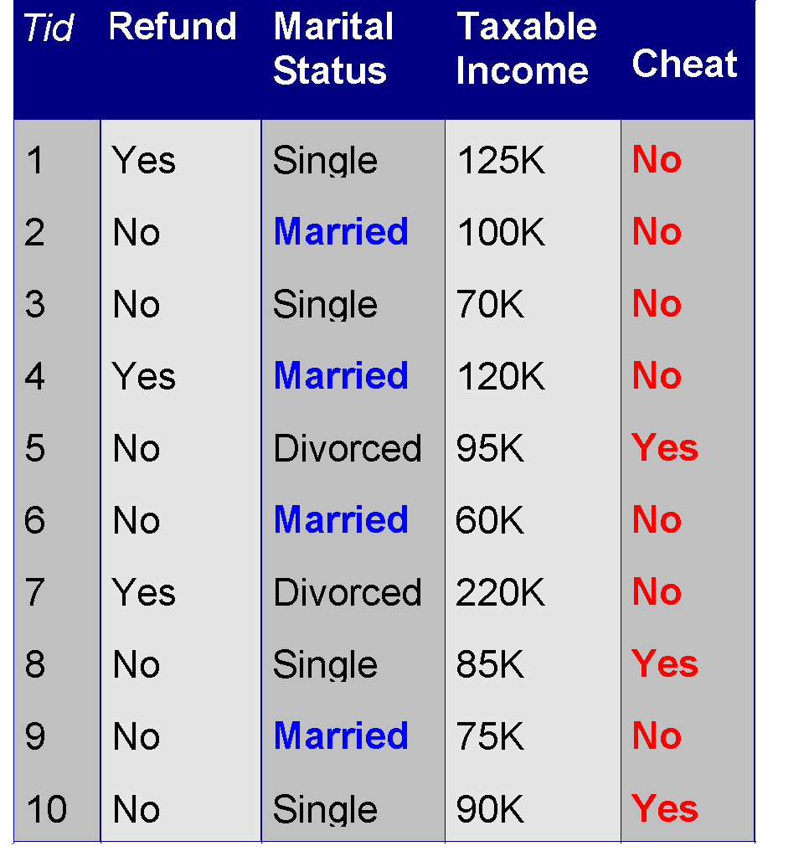
Rules Can Be Simplified
Initial Rule: (Refund=No) ∧ (Status=Married) → No
Simplified Rule: (Status=Married) → No

Slide 10
Effect of Rule Simplification
Rules are no longer mutually exclusive
A record may trigger more than one rule
Solution?
Ordered rule set
Unordered rule set – use voting schemes
Rules are no longer exhaustive
A record may not trigger any rules
Solution?
Use a default class

Slide 11
Ordered Rule Set
Rules are rank ordered according to their priority
An ordered rule set is known as a decision list
When a test record is presented to the classifier
It is assigned to the class label of the highest ranked rule it has triggered
If none of the rules fired, it is assigned to the default class
R1: (Give Birth = no) ∧ (Can Fly = yes) → Birds
R2: (Give Birth = no) ∧ (Live in Water = yes) → Fishes
R3: (Give Birth = yes) ∧ (Blood Type = warm) → Mammals
R4: (Give Birth = no) ∧ (Can Fly = no) → Reptiles
R5: (Live in Water = sometimes) → Amphibians

Slide 12
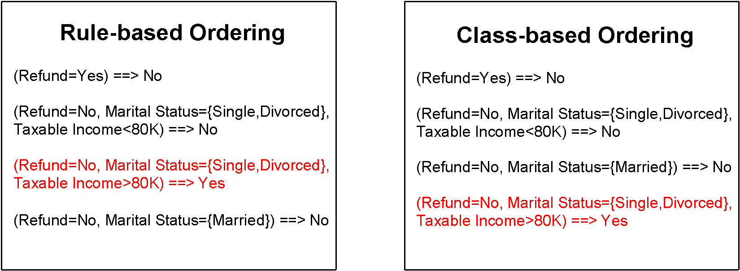
Rule Ordering Schemes
Rule-based ordering
Individual rules are ranked based on their quality
Class-based ordering
Rules that belong to the same class appear together

Slide 13
Building Classification Rules
Direct Method:
Extract rules directly from data
e.g.: RIPPER, CN2, Holte’s 1R
Indirect Method:
Extract rules from other classification models (e.g. decision trees, neural networks, etc).
e.g: C4.5rules

Slide 14
Direct Method: Sequential Covering
Start from an empty rule
Grow a rule using the Learn-One-Rule function
Remove training records covered by the rule
Repeat Step (2) and (3) until stopping criterion is met

Slide 15
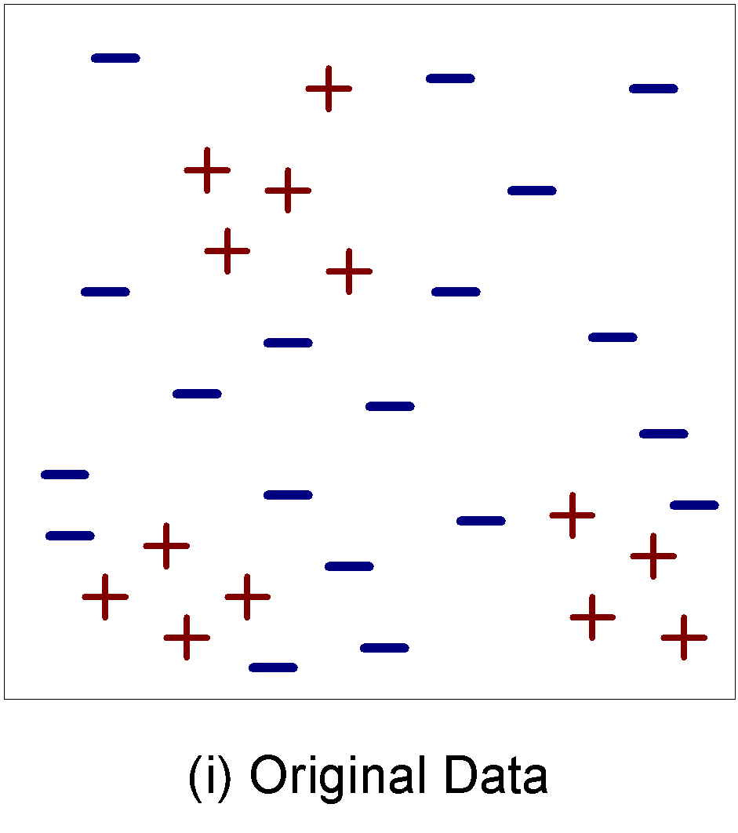
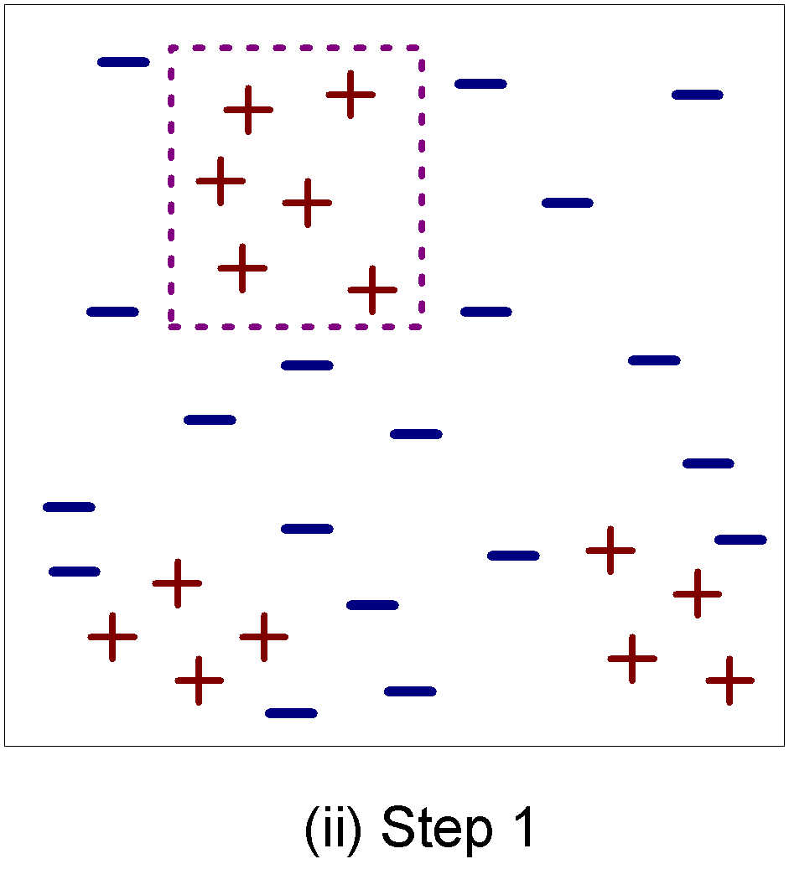
Example of Sequential Covering

Slide 16
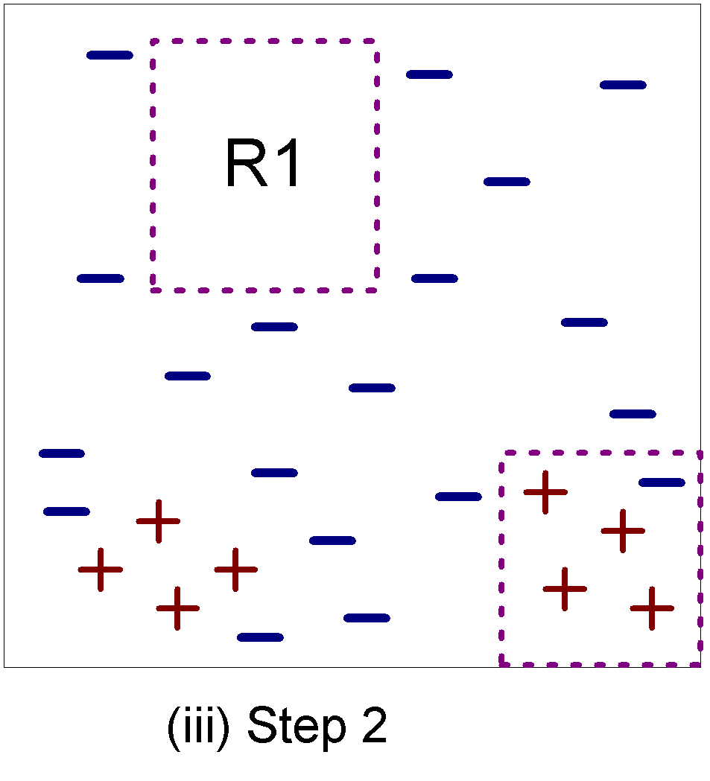
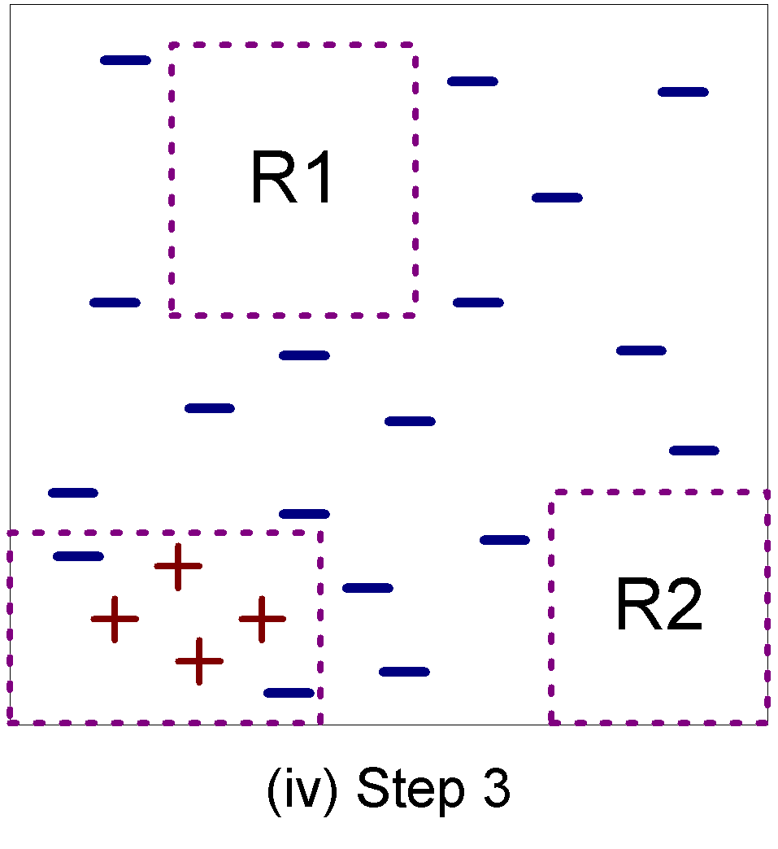
Example of Sequential Covering…

Slide 17
Aspects of Sequential Covering
Rule Growing
Instance Elimination
Rule Evaluation
Stopping Criterion
Rule Pruning

Slide 18
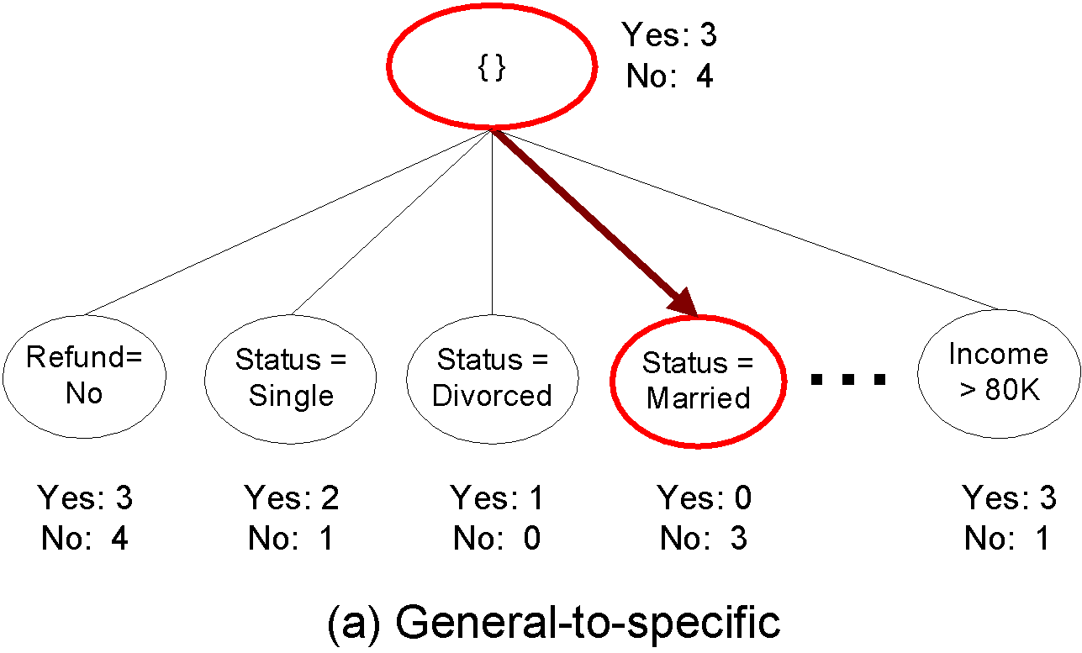
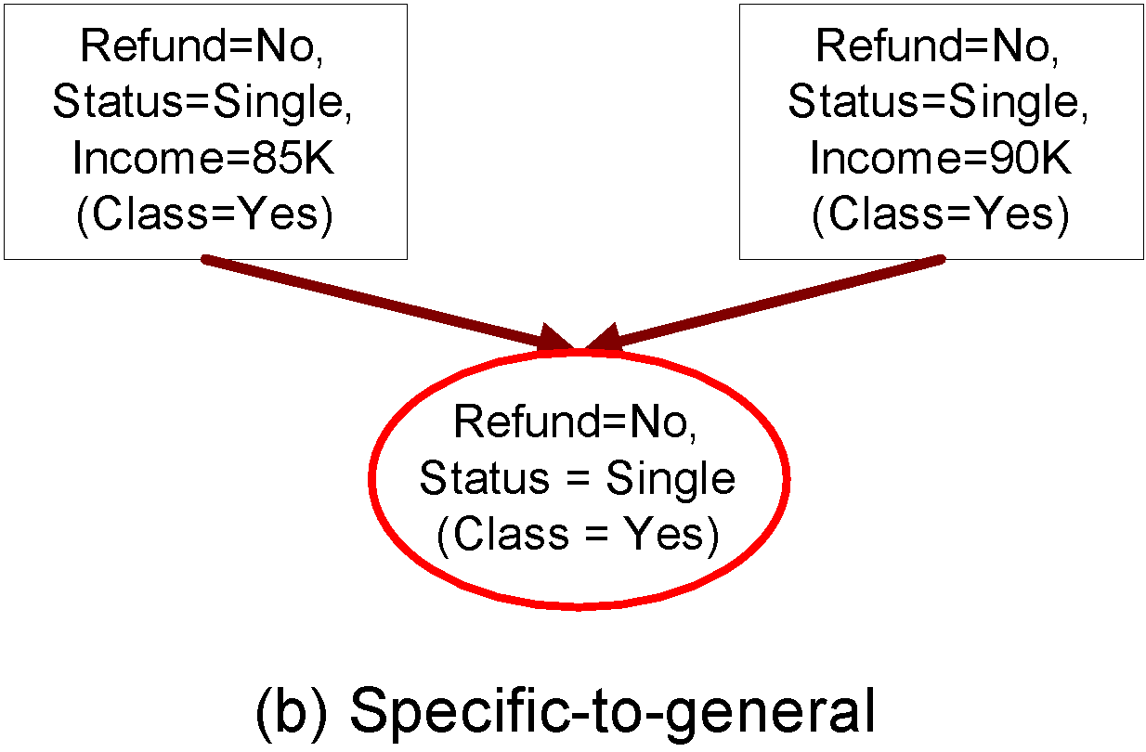
Rule Growing
Two common strategies

Slide 19
Rule Growing (Examples)
CN2 Algorithm:
Start from an empty conjunct: {}
Add conjuncts that minimizes the entropy measure: {A}, {A,B}, …
Determine the rule consequent by taking majority class of instances covered by the rule
RIPPER Algorithm:
Start from an empty rule: {} => class
Add conjuncts that maximizes FOIL’s information gain measure:
R0: {} => class (initial rule)
R1: {A} => class (rule after adding conjunct)
Gain(R0, R1) = t [ log (p1/(p1+n1)) – log (p0/(p0 + n0)) ]
where t: number of positive instances covered by both R0 and R1
p0: number of positive instances covered by R0
n0: number of negative instances covered by R0
p1: number of positive instances covered by R1
n1: number of negative instances covered by R1

Slide 20
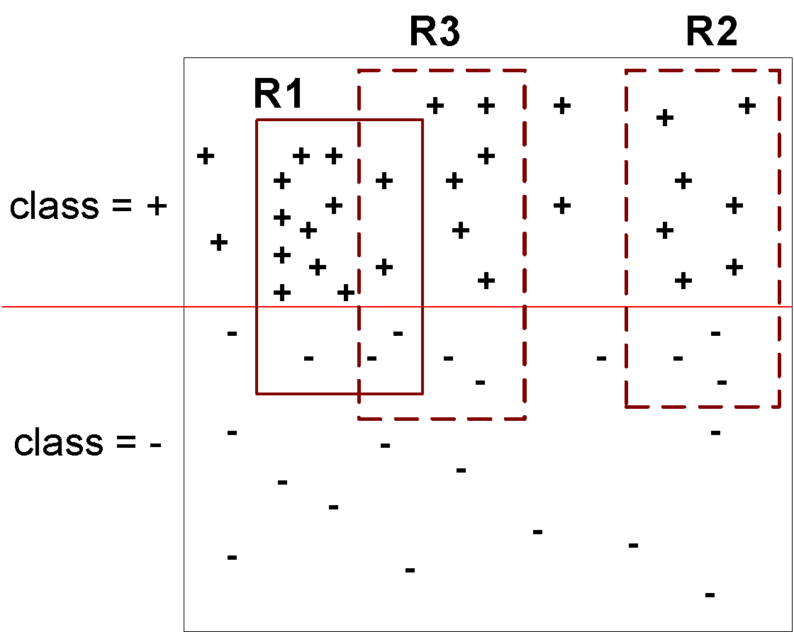
Instance Elimination
Why do we need to eliminate instances?
Otherwise, the next rule is identical to previous rule
Why do we remove positive instances?
Ensure that the next rule is different
Why do we remove negative instances?
Prevent underestimating accuracy of rule
Compare rules R2 and R3 in the diagram

Slide 21
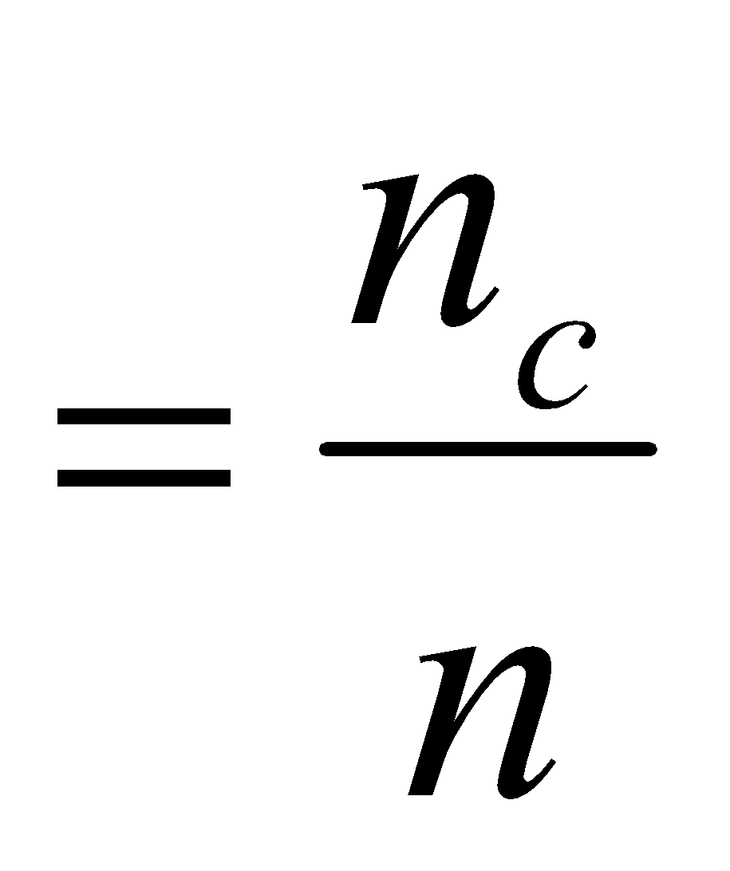
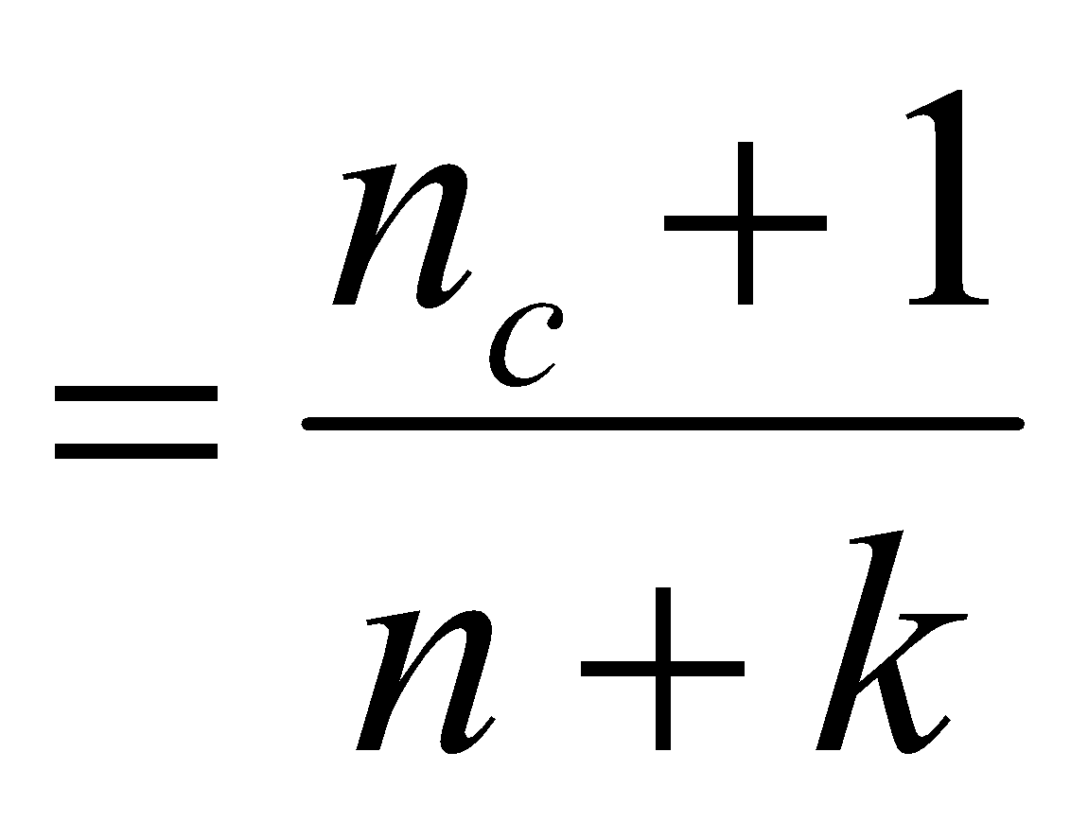
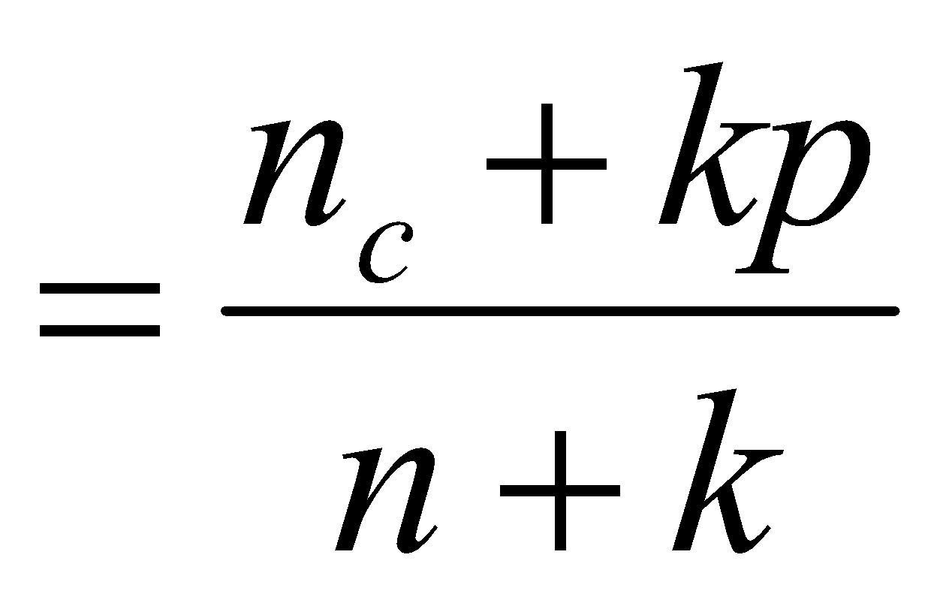
Rule Evaluation
Metrics:
Accuracy
Laplace
M-estimate
n : Number of instances covered by rule
n_{c} : Number of instances covered by rule
k : Number of classes
p : Prior probability

Slide 22
Stopping Criterion and Rule Pruning
Stopping criterion
Compute the gain
If gain is not significant, discard the new rule
Rule Pruning
Similar to post-pruning of decision trees
Reduced Error Pruning:
Remove one of the conjuncts in the rule
Compare error rate on validation set before and after pruning
If error improves, prune the conjunct

Slide 23
Summary of Direct Method
Grow a single rule
Remove Instances from rule
Prune the rule (if necessary)
Add rule to Current Rule Set
Repeat

Slide 24
Direct Method: RIPPER
For 2-class problem, choose one of the classes as positive class, and the other as negative class
Learn rules for positive class
Negative class will be default class
For multi-class problem
Order the classes according to increasing class prevalence (fraction of instances that belong to a particular class)
Learn the rule set for smallest class first, treat the rest as negative class
Repeat with next smallest class as positive class

Slide 25
Direct Method: RIPPER
Growing a rule:
Start from empty rule
Add conjuncts as long as they improve FOIL’s information gain
Stop when rule no longer covers negative examples
Prune the rule immediately using incremental reduced error pruning
Measure for pruning: v = (p-n)/(p+n)
p: number of positive examples covered by the rule in the validation set
n: number of negative examples covered by the rule in the validation set
Pruning method: delete any final sequence of conditions that maximizes v

Slide 26
Direct Method: RIPPER
Building a Rule Set:
Use sequential covering algorithm
Finds the best rule that covers the current set of positive examples
Eliminate both positive and negative examples covered by the rule
Each time a rule is added to the rule set, compute the new description length
stop adding new rules when the new description length is d bits longer than the smallest description length obtained so far

Slide 27
Direct Method: RIPPER
Optimize the rule set:
For each rule r in the rule set R
Consider 2 alternative rules:
Replacement rule (r*): grow new rule from scratch
Revised rule(r’): add conjuncts to extend the rule r
Compare the rule set for r against the rule set for r* and r’
Choose rule set that minimizes MDL principle
Repeat rule generation and rule optimization for the remaining positive examples

Slide 28
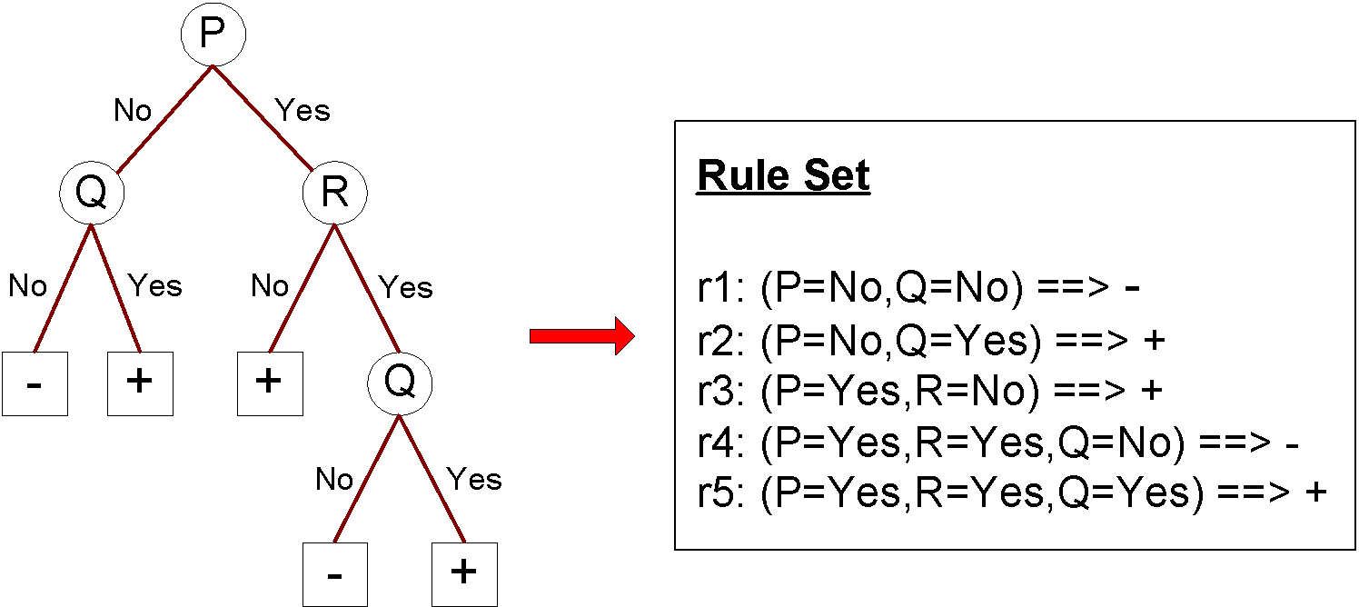
Indirect Methods

Slide 29
Indirect Method: C4.5rules
Extract rules from an unpruned decision tree
For each rule, r: A → y,
consider an alternative rule r’: A’ → y where A’ is obtained by removing one of the conjuncts in A
Compare the pessimistic error rate for r against all r’s
Prune if one of the r’s has lower pessimistic error rate
Repeat until we can no longer improve generalization error

Slide 30
Indirect Method: C4.5rules
Instead of ordering the rules, order subsets of rules (class ordering)
Each subset is a collection of rules with the same rule consequent (class)
Compute description length of each subset
Description length = L(error) + g L(model)
g is a parameter that takes into account the presence of redundant attributes in a rule set (default value = 0.5)

Slide 31
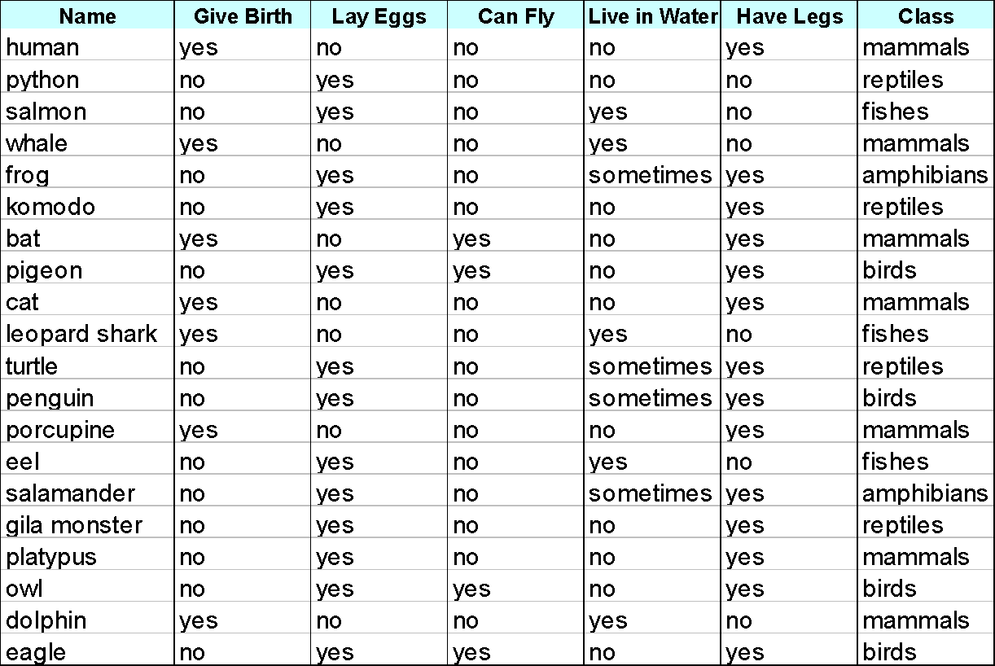
Example

Slide 32
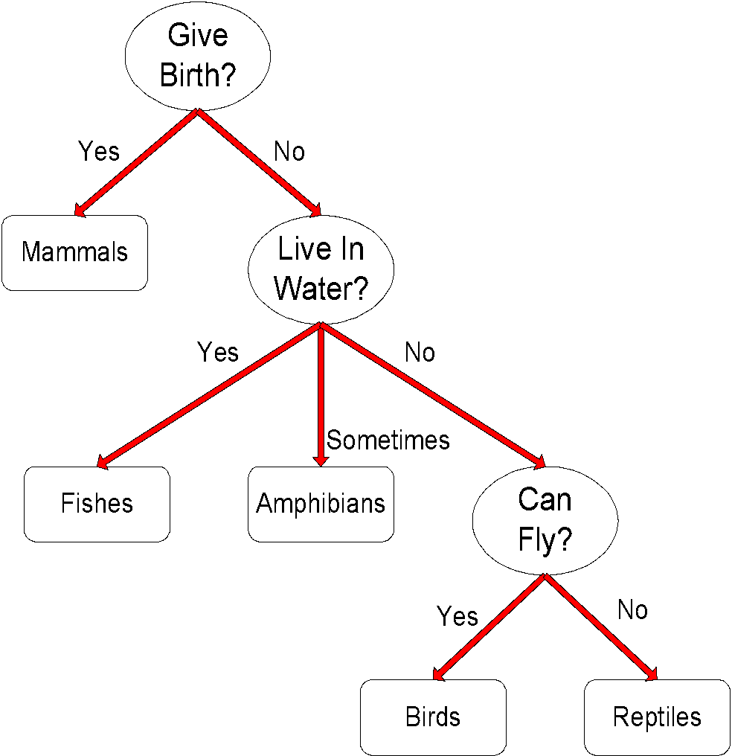
C4.5 versus C4.5rules versus RIPPER
C4.5rules:
(Give Birth=No, Can Fly=Yes) → Birds
(Give Birth=No, Live in Water=Yes) → Fishes
(Give Birth=Yes) → Mammals
(Give Birth=No, Can Fly=No, Live in Water=No) → Reptiles
( ) → Amphibians
RIPPER:
(Live in Water=Yes) → Fishes
(Have Legs=No) → Reptiles
(Give Birth=No, Can Fly=No, Live In Water=No) → Reptiles
(Can Fly=Yes,Give Birth=No) → Birds
() → Mammals

Slide 33
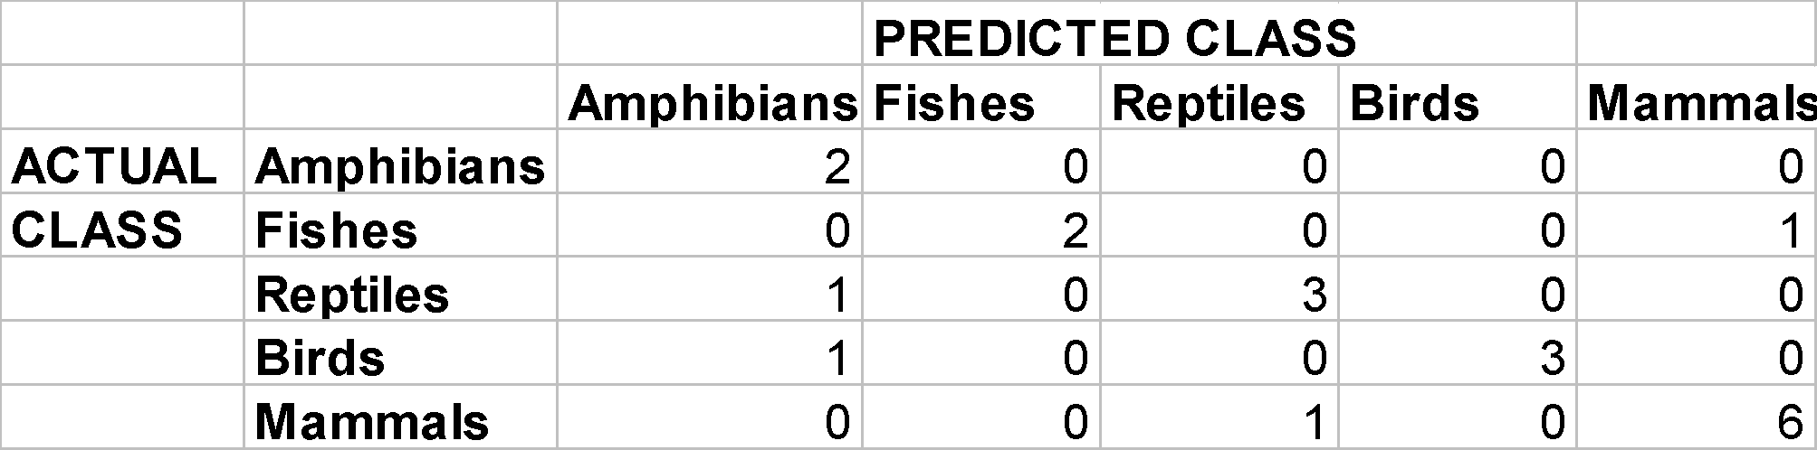

C4.5 versus C4.5rules versus RIPPER
C4.5 and C4.5rules:
RIPPER:

Slide 34
Advantages of Rule-Based Classifiers
As highly expressive as decision trees
Easy to interpret
Easy to generate
Can classify new instances rapidly
Performance comparable to decision trees

Slide 35
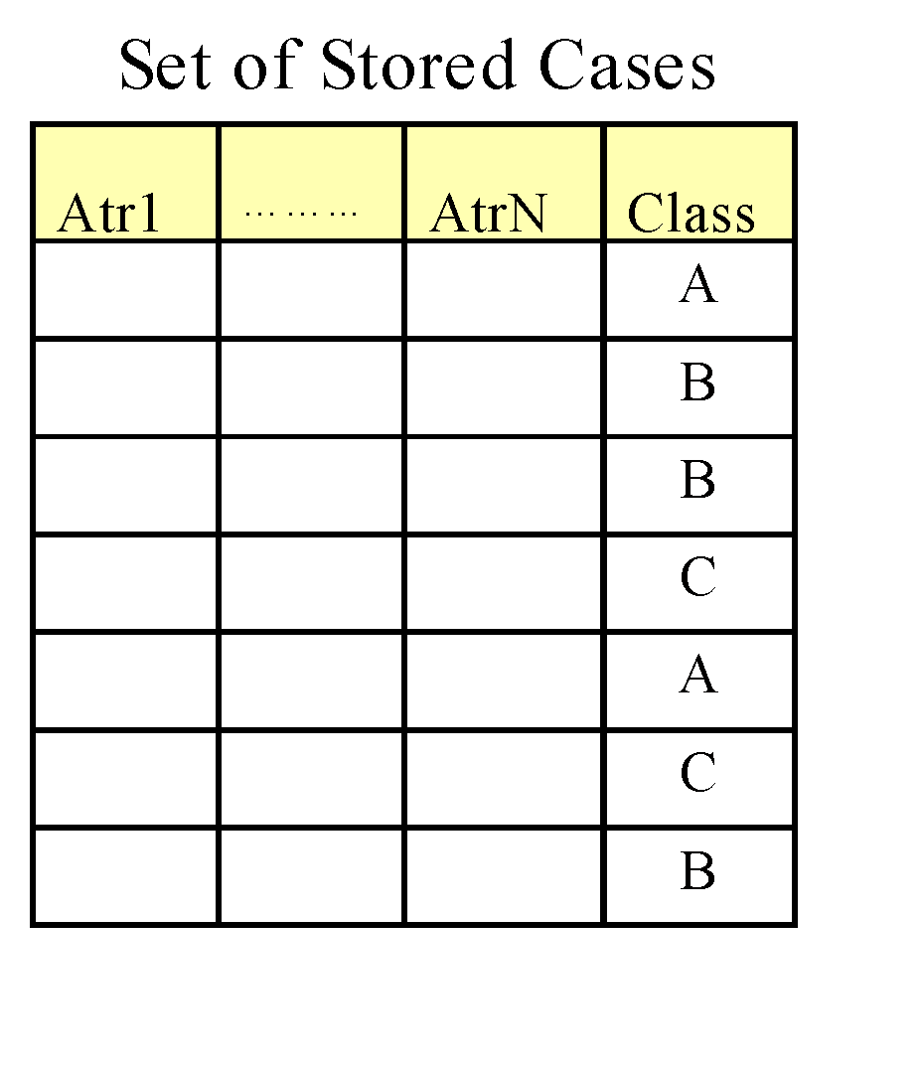
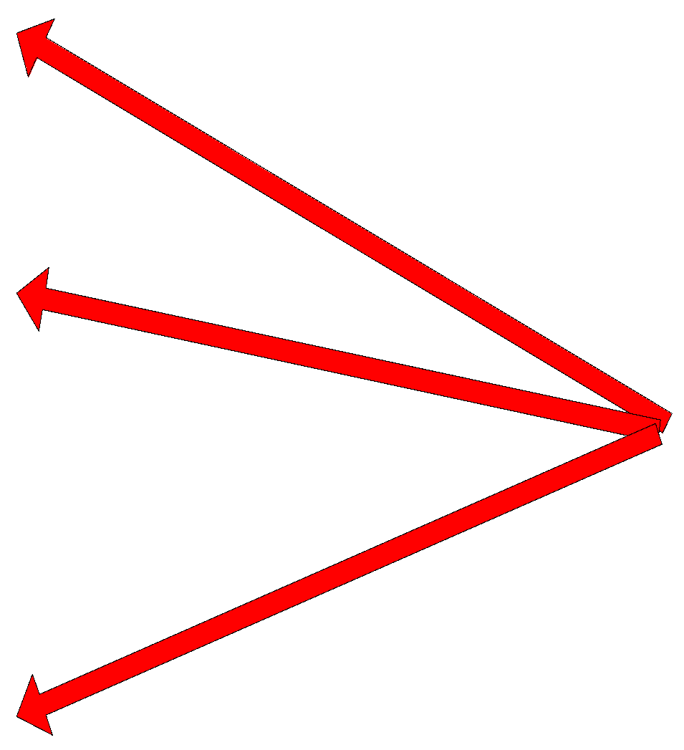
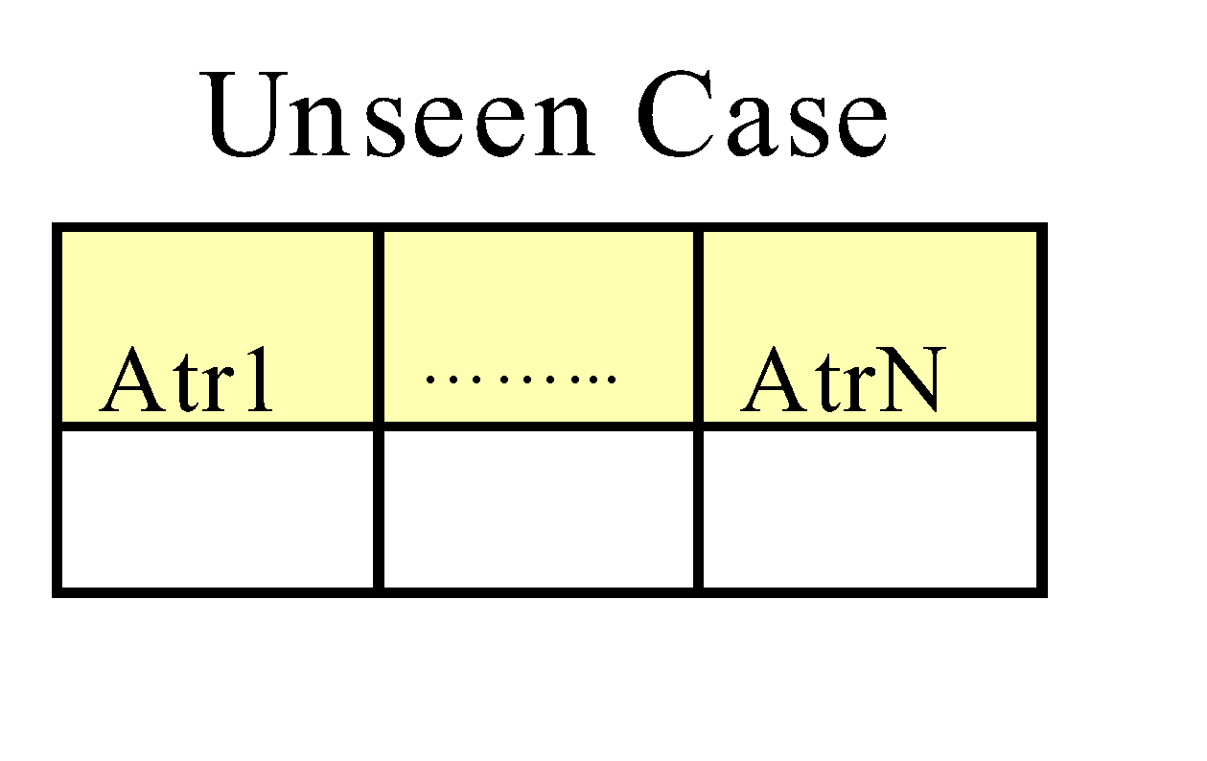
Instance-Based Classifiers
Store the training records
Use training records to predict the class label of unseen cases

Slide 36
Instance Based Classifiers
Examples:
Rote-learner
Memorizes entire training data and performs classification only if attributes of record match one of the training examples exactly
Nearest neighbor
Uses k “closest” points (nearest neighbors) for performing classification

Slide 37

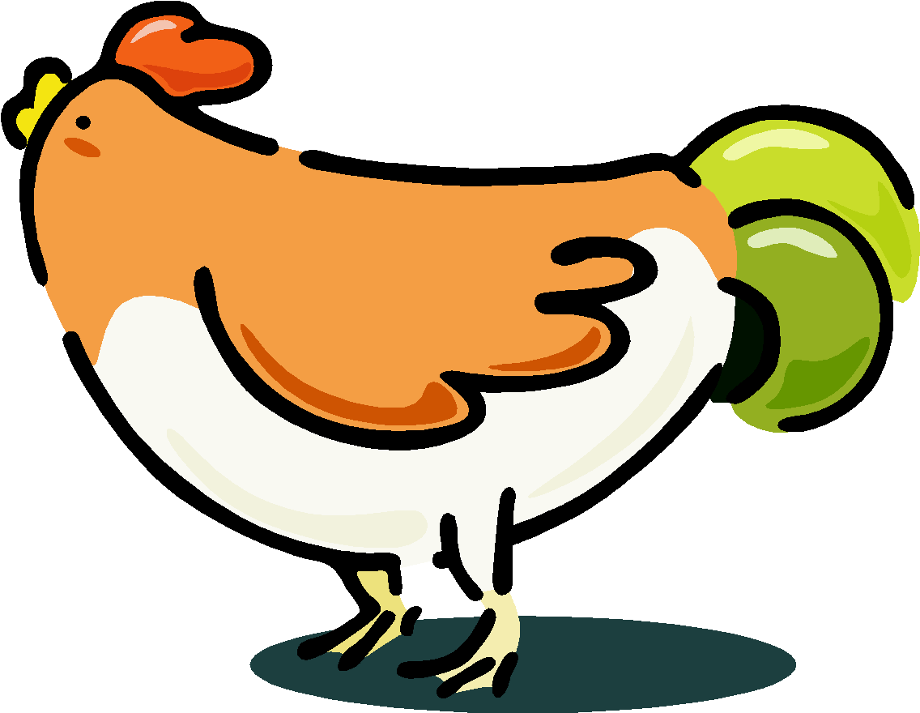


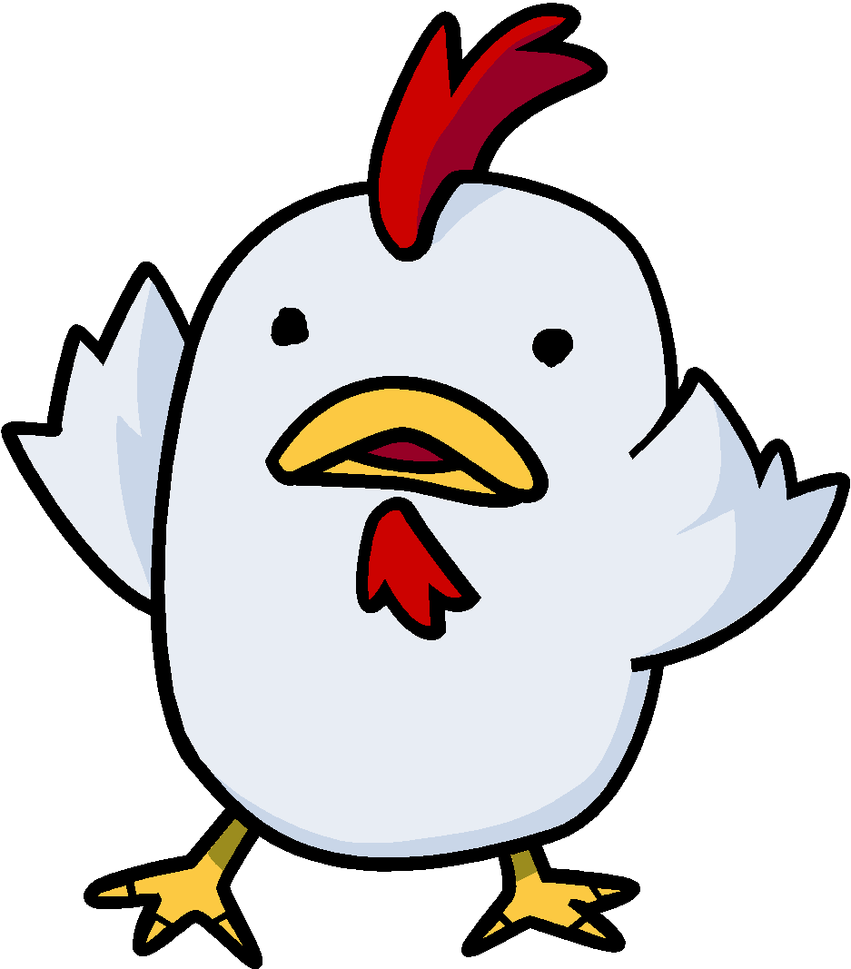

Nearest Neighbor Classifiers
Basic idea:
If it walks like a duck, quacks like a duck, then it’s probably a duck
Compute Distance
Test Record
Training Records
Choose k of the “nearest” records

Slide 38
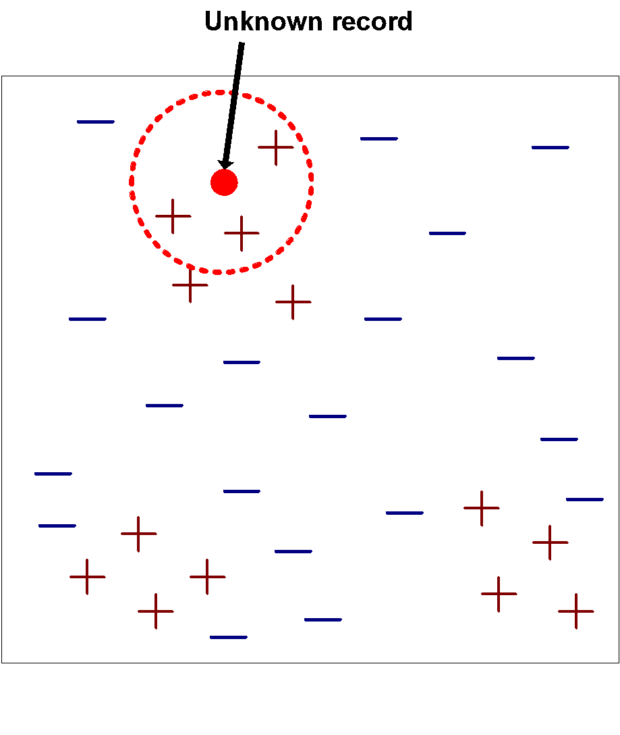
Nearest-Neighbor Classifiers
Requires three things
The set of stored records
Distance Metric to compute distance between records
The value of k, the number of nearest neighbors to retrieve
To classify an unknown record:
Compute distance to other training records
Identify k nearest neighbors
Use class labels of nearest neighbors to determine the class label of unknown record (e.g., by taking majority vote)

Slide 39
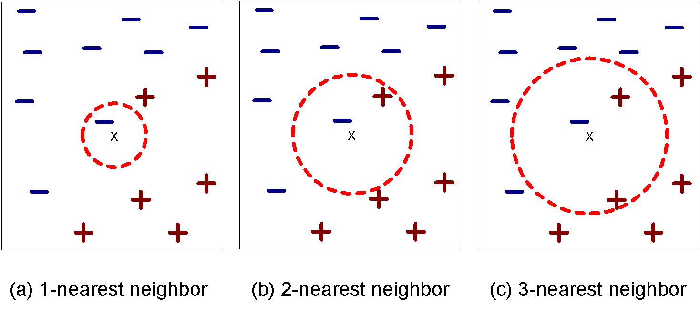
Definition of Nearest Neighbor
K-nearest neighbors of a record x are data points that have the k smallest distance to x

Slide 40
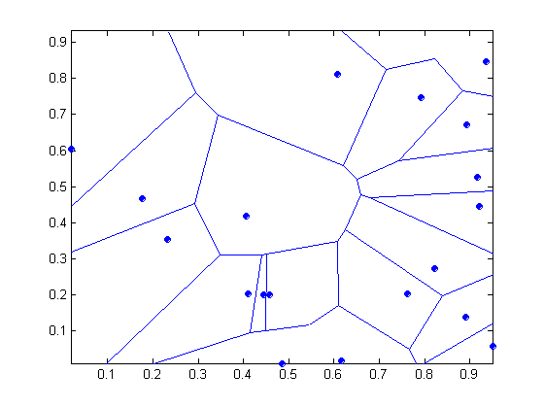
1 nearest-neighbor
Voronoi Diagram

Slide 41
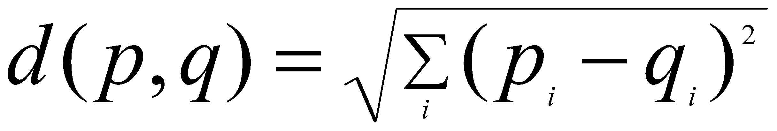
Nearest Neighbor Classification
Compute distance between two points:
Euclidean distance
Determine the class from nearest neighbor list
take the majority vote of class labels among the k-nearest neighbors
Weigh the vote according to distance
weight factor, w = 1/d²

Slide 42
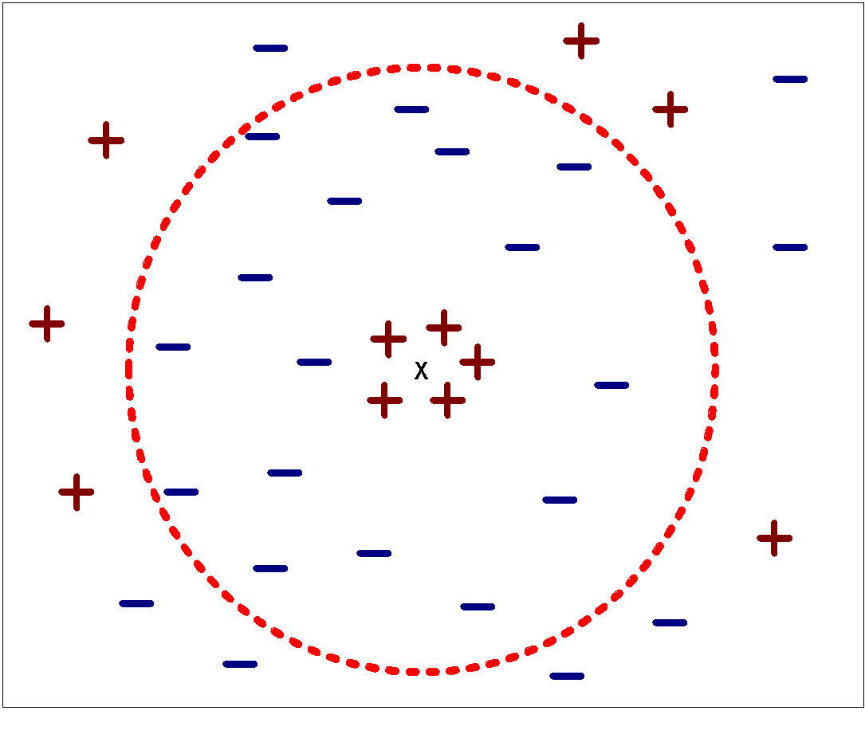
Nearest Neighbor Classification…
Choosing the value of k:
If k is too small, sensitive to noise points
If k is too large, neighborhood may include points from other classes

Slide 43
Nearest Neighbor Classification…
Scaling issues
Attributes may have to be scaled to prevent distance measures from being dominated by one of the attributes
Example:
height of a person may vary from 1.5m to 1.8m
weight of a person may vary from 90lb to 300lb
income of a person may vary from $10K to $1M

Slide 44
Nearest Neighbor Classification…
Problem with Euclidean measure:
High dimensional data
curse of dimensionality
Can produce counter-intuitive results
1 1 1 1 1 1 1 1 1 1 1 0
1 0 0 0 0 0 0 0 0 0 0 0
vs
0 1 1 1 1 1 1 1 1 1 1 1
0 0 0 0 0 0 0 0 0 0 0 1
d = 1.4142
d = 1.4142
Solution: Normalize the vectors to unit length

Slide 45
Nearest neighbor Classification…
k-NN classifiers are lazy learners
It does not build models explicitly
Unlike eager learners such as decision tree induction and rule-based systems
Classifying unknown records are relatively expensive

Slide 46
Example: PEBLS
PEBLS: Parallel Examplar-Based Learning System (Cost & Salzberg)
Works with both continuous and nominal features
For nominal features, distance between two nominal values is computed using modified value difference metric (MVDM)
Each record is assigned a weight factor
Number of nearest neighbor, k = 1

Slide 47
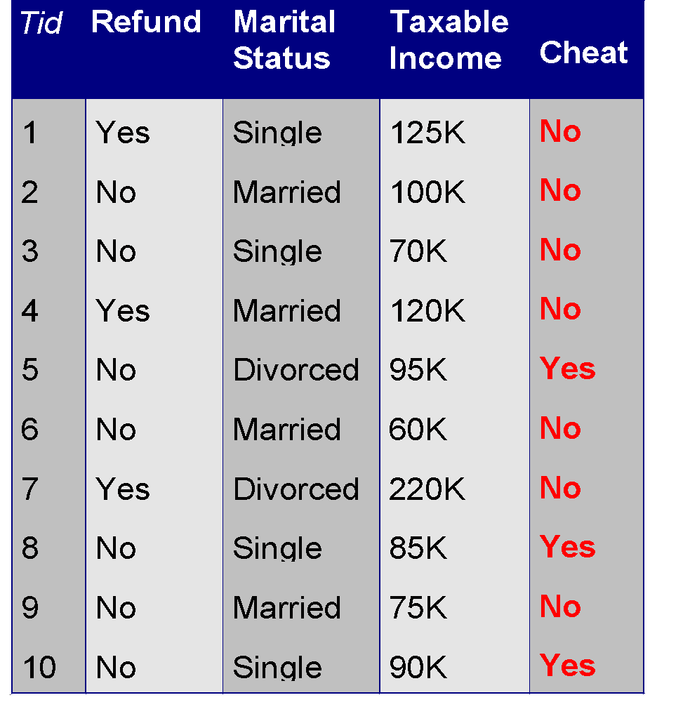
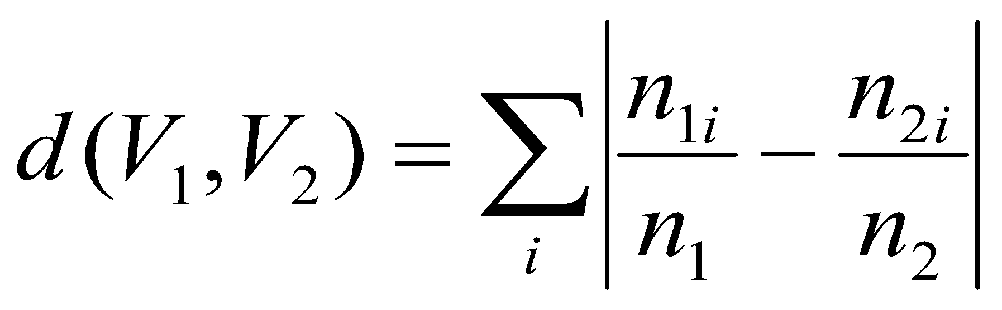
Example: PEBLS
Distance between nominal attribute values:
d(Single,Married)
= | 2/4 – 0/4 | + | 2/4 – 4/4 | = 1
d(Single,Divorced)
= | 2/4 – 1/2 | + | 2/4 – 1/2 | = 0
d(Married,Divorced)
= | 0/4 – 1/2 | + | 4/4 – 1/2 | = 1
d(Refund=Yes,Refund=No)
= | 0/3 – 3/7 | + | 3/3 – 4/7 | = 6/7
Class | Marital Status
 | Single | Married | Divorced
Yes | 2 | 0 | 1
No | 2 | 4 | 1
Class | Refund
 | Yes | No
Yes | 0 | 3
No | 3 | 4

Slide 48
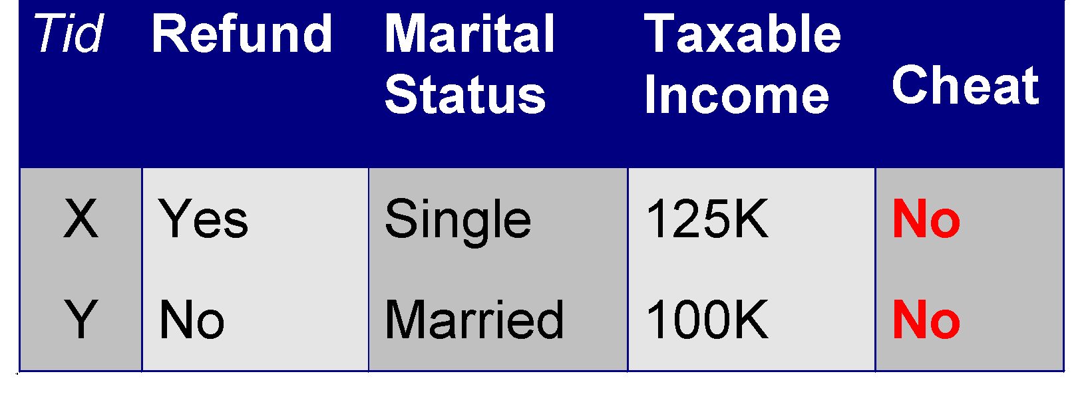
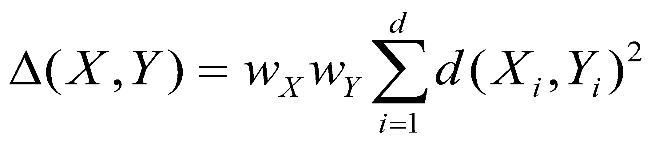
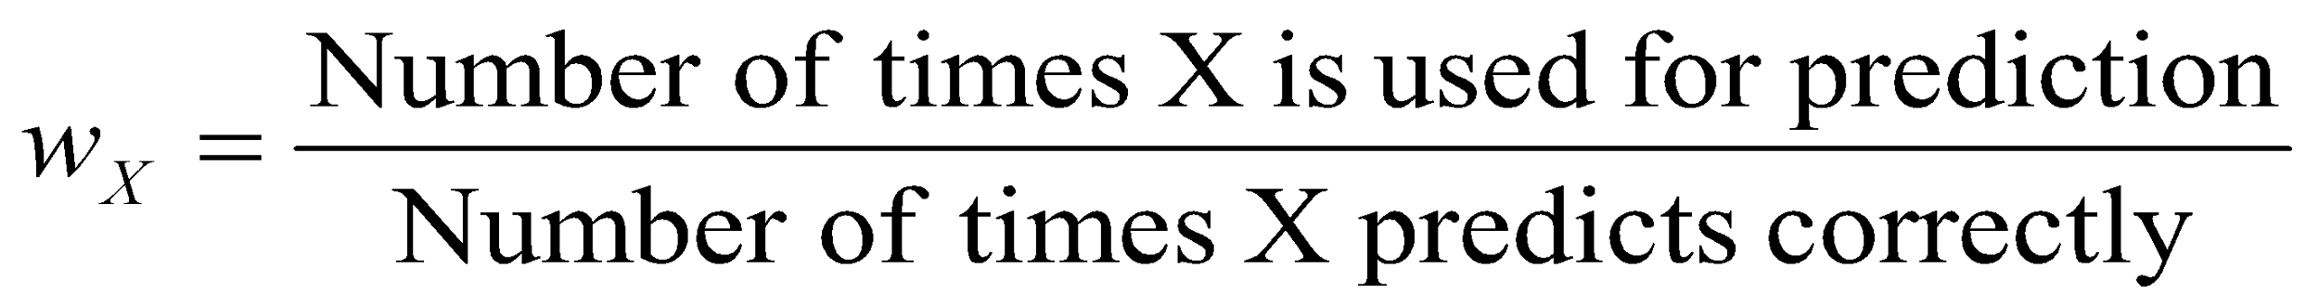
Example: PEBLS
Distance between record X and record Y:
where:
w_{X} ≅ 1 if X makes accurate prediction most of the time
w_{X} > 1 if X is not reliable for making predictions

Slide 49
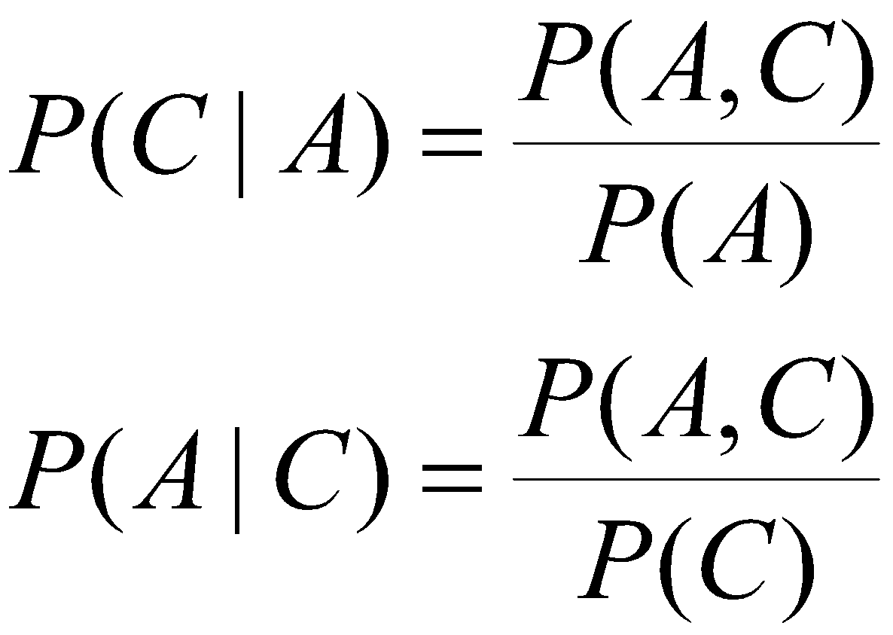
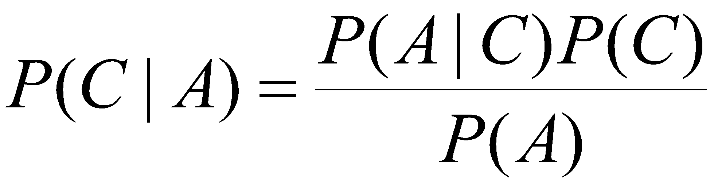
Bayes Classifier
A probabilistic framework for solving classification problems
Conditional Probability:
Bayes theorem:

Slide 50
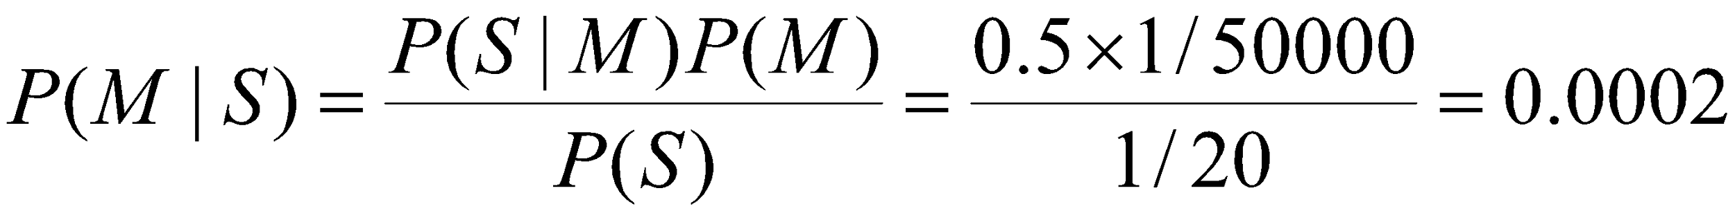
Example of Bayes Theorem
Given:
A doctor knows that meningitis causes stiff neck 50% of the time
Prior probability of any patient having meningitis is 1/50,000
Prior probability of any patient having stiff neck is 1/20
If a patient has stiff neck, what’s the probability he/she has meningitis?

Slide 51
Bayesian Classifiers
Consider each attribute and class label as random variables
Given a record with attributes (A₁, A₂,…,A_{n})
Goal is to predict class C
Specifically, we want to find the value of C that maximizes P(C| A₁, A₂,…,A_{n} )
Can we estimate P(C| A₁, A₂,…,A_{n} ) directly from data?

Slide 52
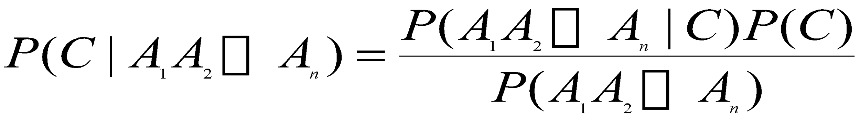
Bayesian Classifiers
Approach:
compute the posterior probability P(C | A₁, A₂, …, A_{n}) for all values of C using the Bayes theorem
Choose value of C that maximizes P(C | A₁, A₂, …, A_{n})
Equivalent to choosing value of C that maximizes P(A₁, A₂, …, A_{n}|C) P(C)
How to estimate P(A₁, A₂, …, A_{n} | C )?

Slide 53
Naïve Bayes Classifier
Assume independence among attributes A_{i} when class is given:
P(A₁, A₂, …, A_{n} |C) = P(A₁| C_{j}) P(A₂| C_{j})… P(A_{n}| C_{j})
Can estimate P(A_{i}| C_{j}) for all A_{i} and C_{j}.
New point is classified to C_{j} if P(C_{j}) Π P(A_{i}| C_{j}) is maximal.

Slide 54
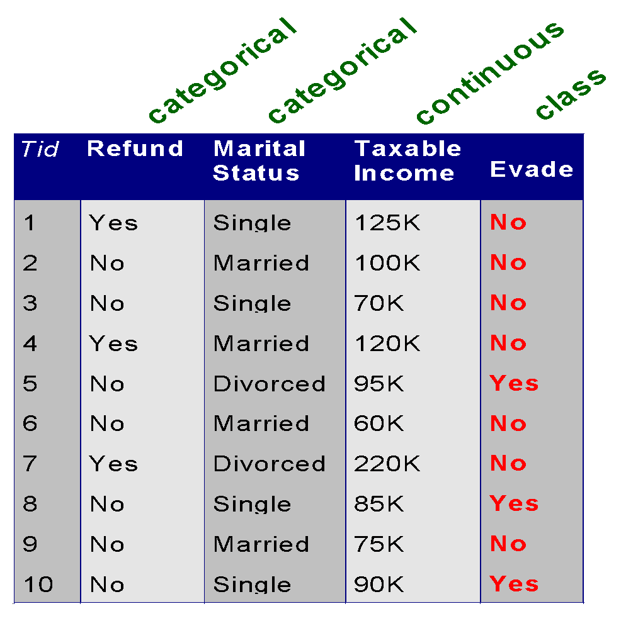
How to Estimate Probabilities from Data?
Class: P(C) = N_{c}/N
e.g., P(No) = 7/10, P(Yes) = 3/10
For discrete attributes: P(A_{i} | C_{k}) = |A_{ik}|/ N_{c}
where |A_{ik}| is number of instances having attribute A_{i} and belongs to class C_{k}
Examples:
P(Status=Married|No) = 4/7 P(Refund=Yes|Yes)=0
k

Slide 55
How to Estimate Probabilities from Data?
For continuous attributes:
Discretize the range into bins
one ordinal attribute per bin
violates independence assumption
Two-way split: (A < v) or (A > v)
choose only one of the two splits as new attribute
Probability density estimation:
Assume attribute follows a normal distribution
Use data to estimate parameters of distribution (e.g., mean and standard deviation)
Once probability distribution is known, can use it to estimate the conditional probability P(A_{i}|c)
k

Slide 56
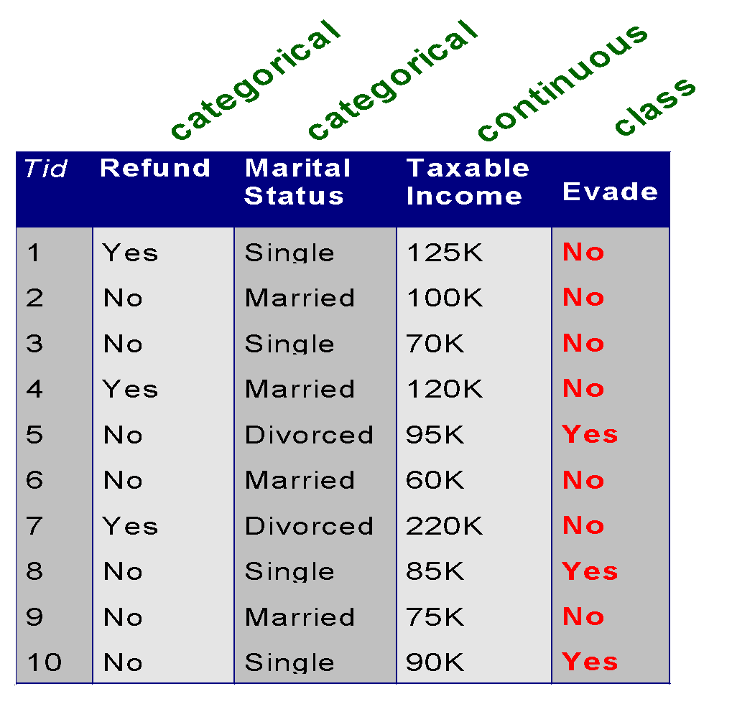
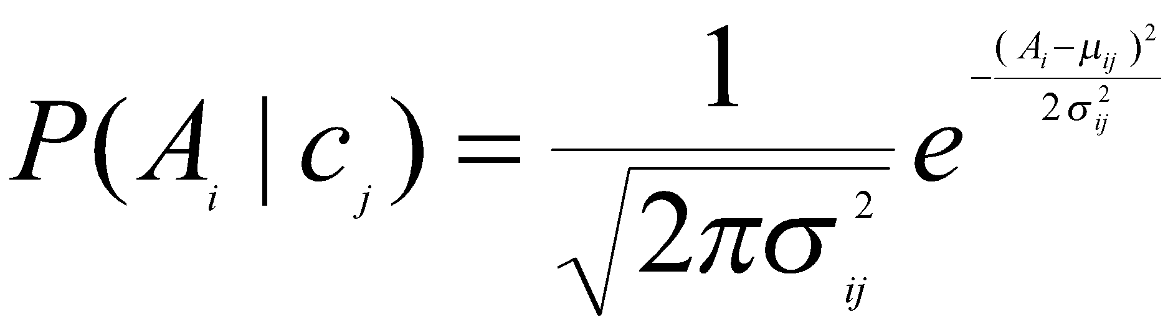
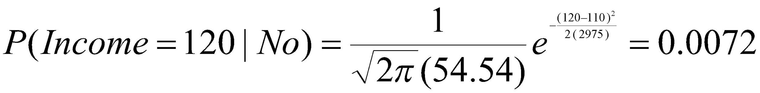
How to Estimate Probabilities from Data?
Normal distribution:
One for each (A_{i},c_{i}) pair
For (Income, Class=No):
If Class=No
sample mean = 110
sample variance = 2975

Slide 57
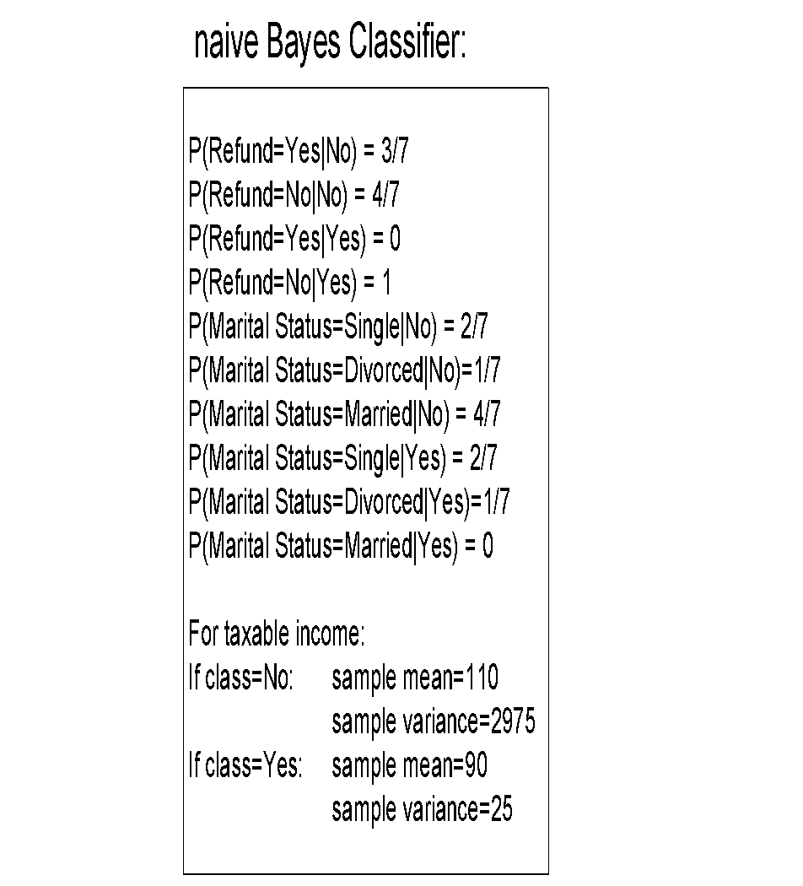
Example of Naïve Bayes Classifier
Given a Test Record:
P(X|Class=No) = P(Refund=No|Class=No) × P(Married| Class=No) × P(Income=120K| Class=No) = 4/7 × 4/7 × 0.0072 = 0.0024
P(X|Class=Yes) = P(Refund=No| Class=Yes) × P(Married| Class=Yes) × P(Income=120K| Class=Yes) = 1 × 0 × 1.2 × 10⁻⁹ = 0
Since P(X|No)P(No) > P(X|Yes)P(Yes)
Therefore P(No|X) > P(Yes|X) => Class = No

Slide 58
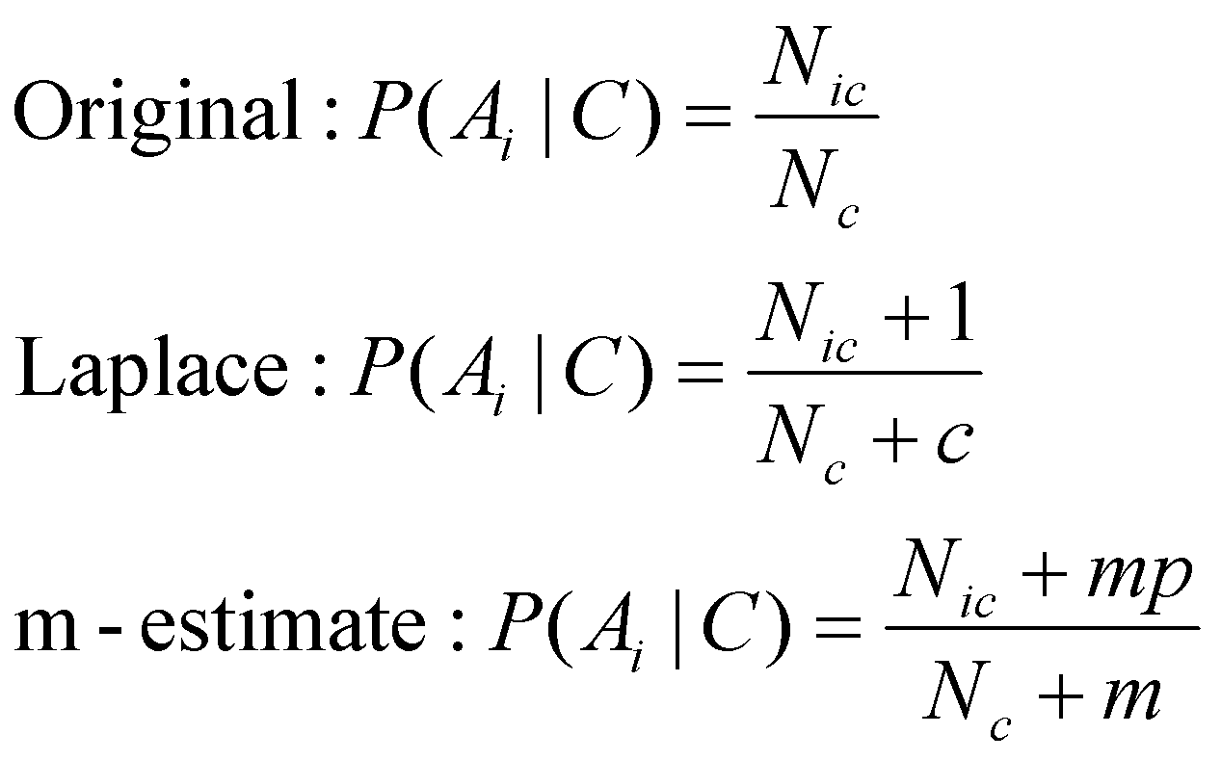
Naïve Bayes Classifier
If one of the conditional probability is zero, then the entire expression becomes zero
Probability estimation:
c: number of classes
p: prior probability
m: parameter

Slide 59
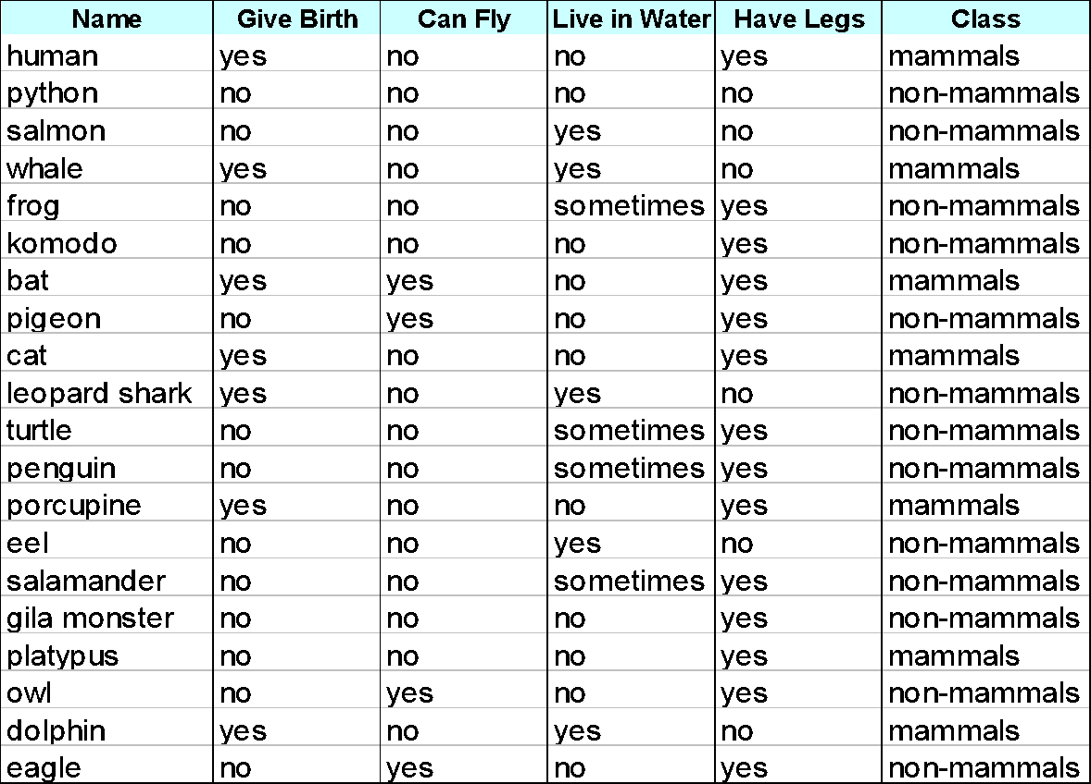
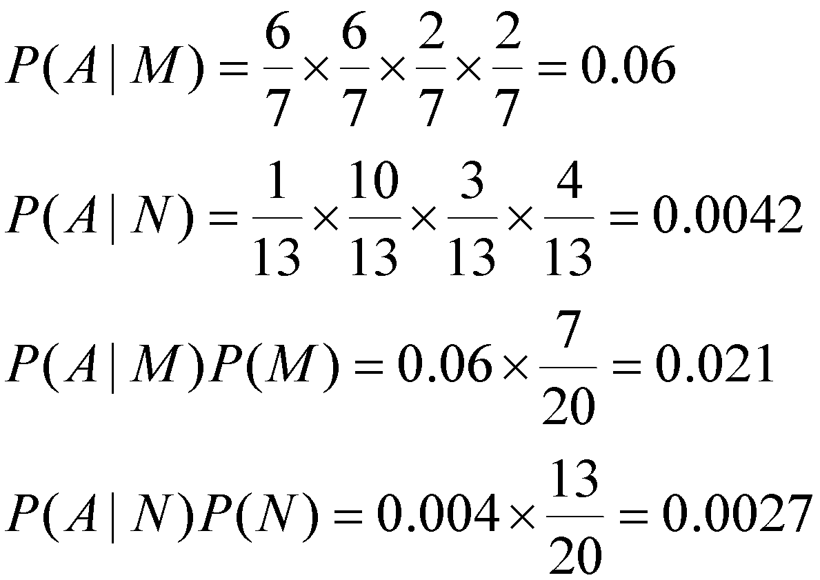
Example of Naïve Bayes Classifier
A: attributes
M: mammals
N: non-mammals
P(A|M)P(M) > P(A|N)P(N)
=> Mammals

Slide 60
Naïve Bayes (Summary)
Robust to isolated noise points
Handle missing values by ignoring the instance during probability estimate calculations
Robust to irrelevant attributes
Independence assumption may not hold for some attributes
Use other techniques such as Bayesian Belief Networks (BBN)

Slide 61
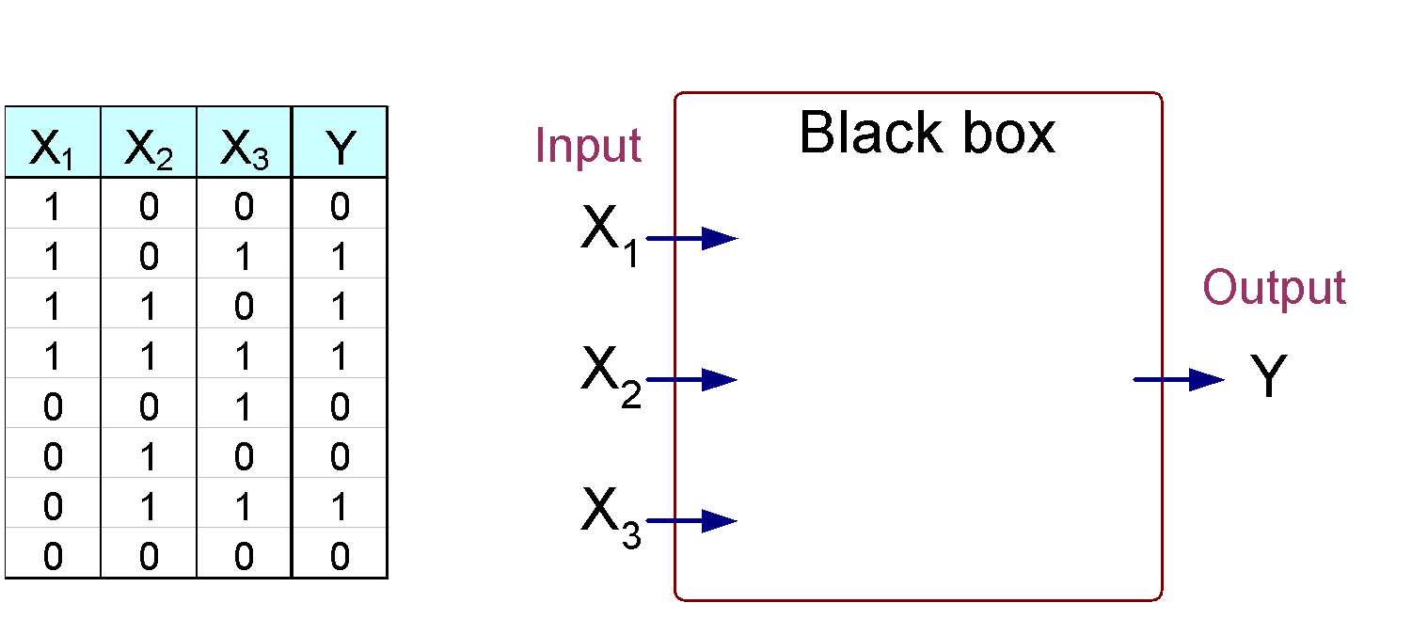
Artificial Neural Networks (ANN)
Output Y is 1 if at least two of the three inputs are equal to 1.

Slide 62
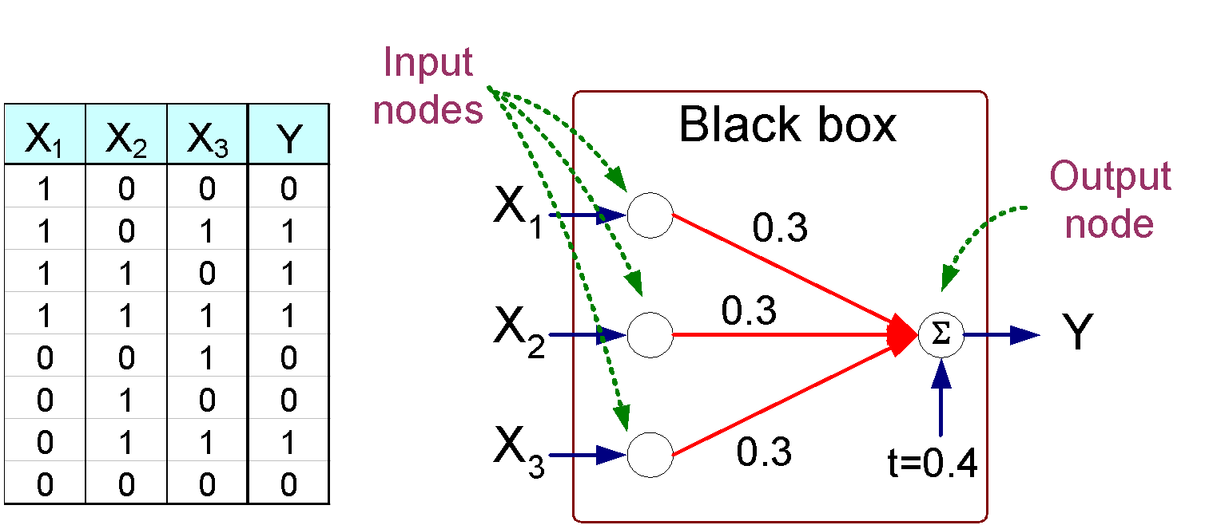

Artificial Neural Networks (ANN)

Slide 63



Artificial Neural Networks (ANN)
Model is an assembly of inter-connected nodes and weighted links
Output node sums up each of its input value according to the weights of its links
Compare output node against some threshold t
Perceptron Model
or

Slide 64


General Structure of ANN
Training ANN means learning the weights of the neurons

Slide 65

Algorithm for learning ANN
Initialize the weights (w₀, w₁, …, w_{k})
Adjust the weights in such a way that the output of ANN is consistent with class labels of training examples
Objective function:
Find the weights w_{i}’s that minimize the above objective function
e.g., backpropagation algorithm (see lecture notes)

Slide 66

Support Vector Machines
Find a linear hyperplane (decision boundary) that will separate the data

Slide 67

Support Vector Machines
One Possible Solution

Slide 68

Support Vector Machines
Another possible solution

Slide 69
Support Vector Machines
Other possible solutions

Slide 70

Support Vector Machines
Which one is better? B1 or B2?
How do you define better?

Slide 71

Support Vector Machines
Find hyperplane maximizes the margin => B1 is better than B2

Slide 72






Support Vector Machines

Slide 73


Support Vector Machines
We want to maximize:
Which is equivalent to minimizing:
But subjected to the following constraints:
This is a constrained optimization problem
Numerical approaches to solve it (e.g., quadratic programming)

Slide 74

Support Vector Machines
What if the problem is not linearly separable?

Slide 75


Support Vector Machines
What if the problem is not linearly separable?
Introduce slack variables
Need to minimize:
Subject to:

Slide 76

Nonlinear Support Vector Machines
What if decision boundary is not linear?

Slide 77

Nonlinear Support Vector Machines
Transform data into higher dimensional space

Slide 78
Ensemble Methods
Construct a set of classifiers from the training data
Predict class label of previously unseen records by aggregating predictions made by multiple classifiers

Slide 79

General Idea

Slide 80

Why does it work?
Suppose there are 25 base classifiers
Each classifier has error rate, ε = 0.35
Assume classifiers are independent
Probability that the ensemble classifier makes a wrong prediction:

Slide 81
Examples of Ensemble Methods
How to generate an ensemble of classifiers?
Bagging
Boosting

Slide 82

Bagging
Sampling with replacement
Build classifier on each bootstrap sample
Each sample has probability (1 – 1/n)^{n} of being selected

Slide 83
Boosting
An iterative procedure to adaptively change distribution of training data by focusing more on previously misclassified records
Initially, all N records are assigned equal weights
Unlike bagging, weights may change at the end of boosting round

Slide 84

Boosting
Records that are wrongly classified will have their weights increased
Records that are classified correctly will have their weights decreased
Example 4 is hard to classify
Its weight is increased, therefore it is more likely to be chosen again in subsequent rounds

Slide 85



Example: AdaBoost
Base classifiers: C₁, C₂, …, C_{T}
Error rate:
Importance of a classifier:

Slide 86


Example: AdaBoost
Weight update:
If any intermediate rounds produce error rate higher than 50%, the weights are reverted back to 1/n and the resampling procedure is repeated
Classification:

Slide 87


Illustrating AdaBoost
Initial weights for each data point
Data points for training

Slide 88

Illustrating AdaBoost

